Slide 1
Unit Testing with xUnit.net-Part-2
Kishorekumar

Slide 2
Agenda
Data-Driven Tests
Shared Context between Tests
Extensibility
Mocking
Comparing xUnit.net with other Frameworks

Slide 3
Data-Driven Tests

Slide 4
Data Driven Tests
A single test method that can be executed multiple times, each time using a discreet set of test data, with each execution representing an individual case.
Benefits
Reduced test Code Duplication
Reduced Maintenance Cost
Add New test cases More Quickly
External test data Sources

Slide 5
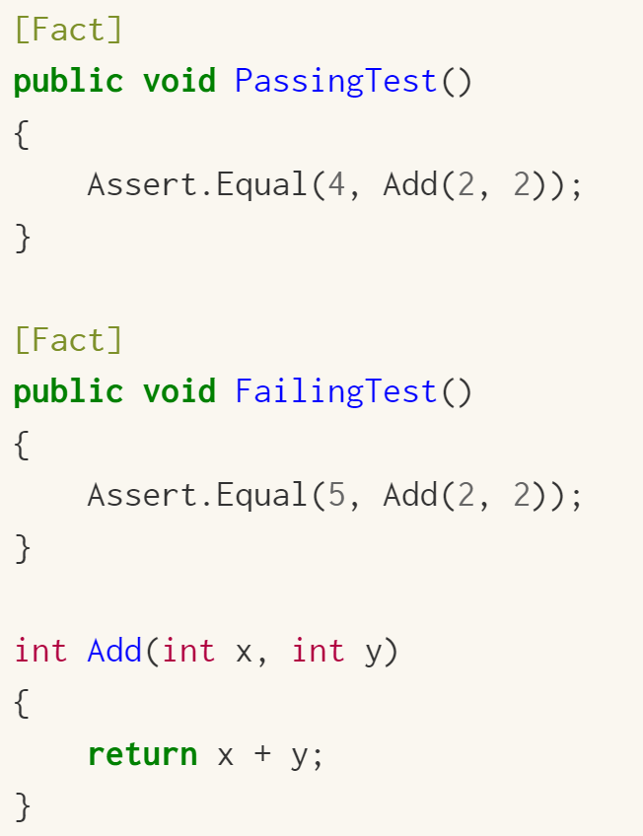
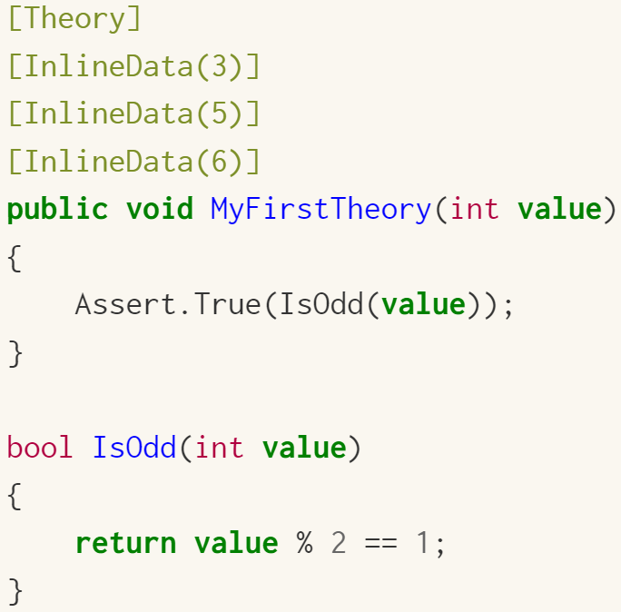
Two different major types of unit tests
Facts are tests which are always true. They test invariant conditions.
Theories are tests which are only true for a particular set of data (Data Driven Tests)

Slide 6
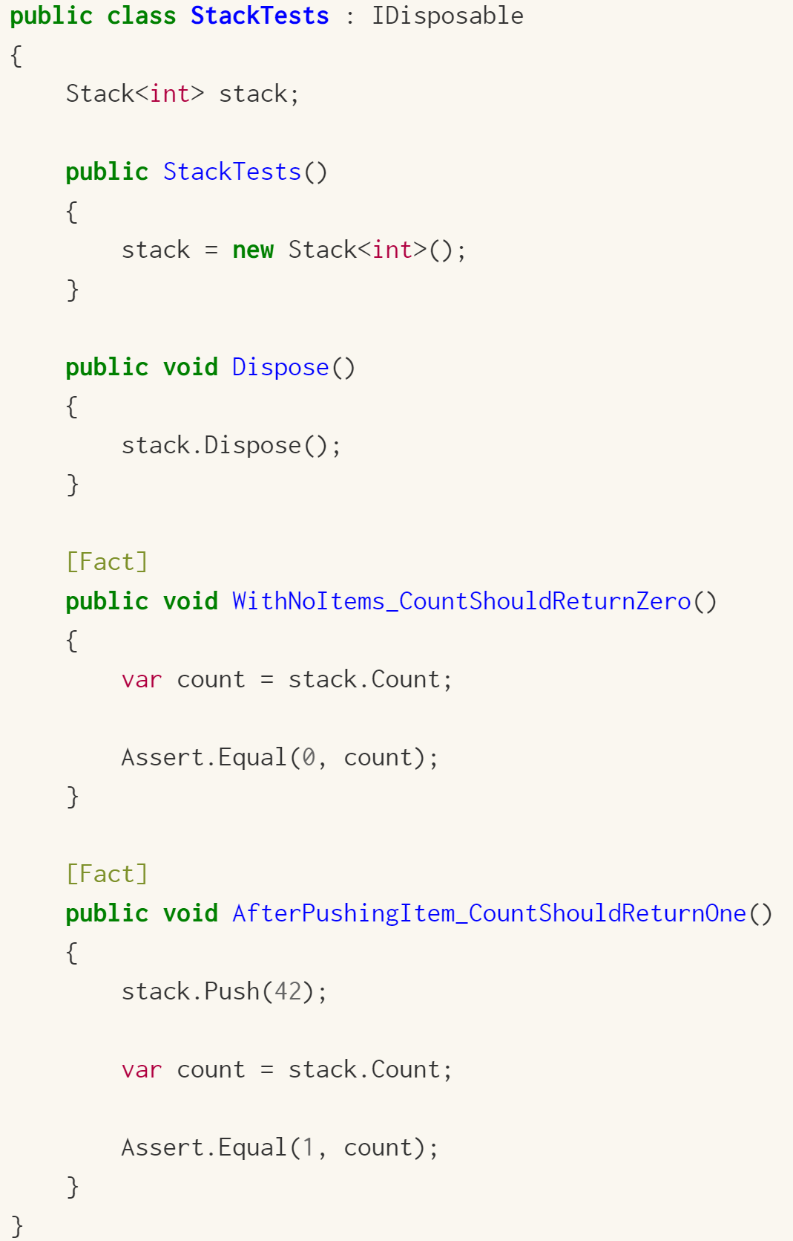
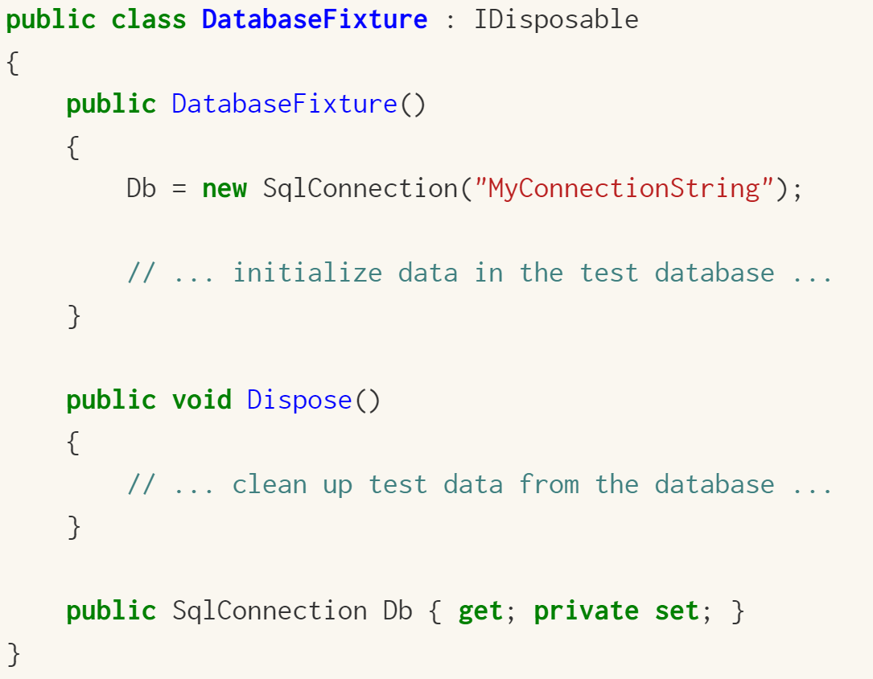
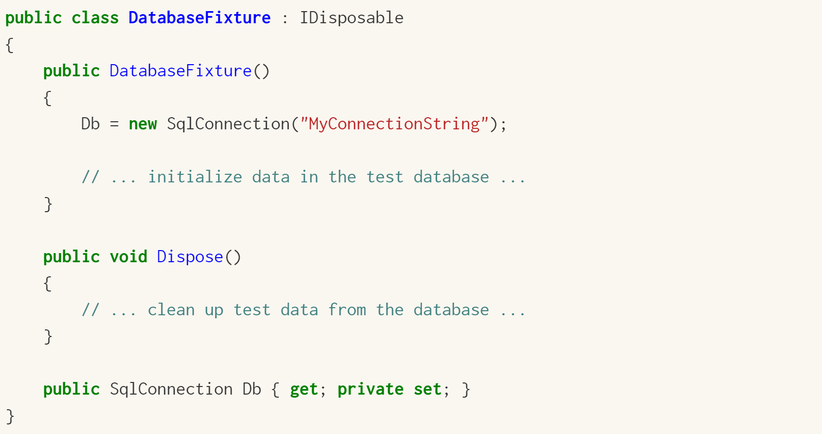
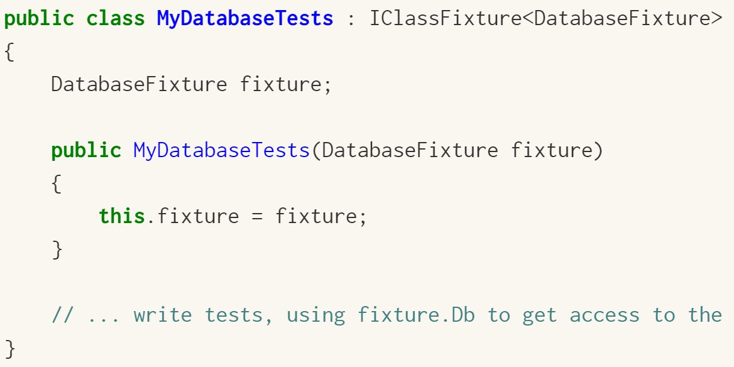
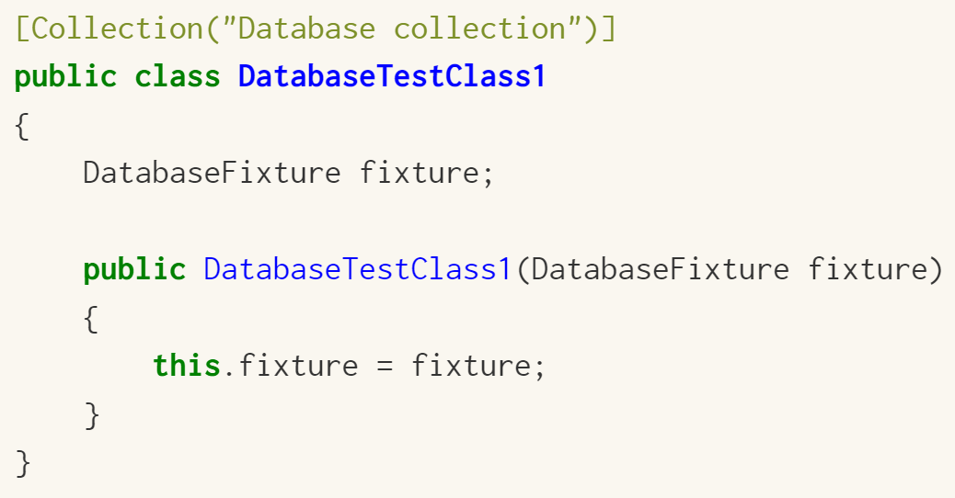
Shared Context between Tests http://xunit.github.io/docs/shared-context.html
Constructor and Dispose
shared setup/cleanup code without sharing object instances
Class Fixtures
shared object instance across tests in a single class
Collection Fixtures
shared object instances across multiple test classes

Slide 7
Extensibility

Slide 8
xUnit Extensibility
Assert (Sample: AssertExtensions ) Use 3rd party assertions or create custom
Before/After (Sample : UseCulture) Run code before & after each test runs
Class Fixtures (Sample : ClassFixtureExample) Run code before & after all tests in test class
Collection Fixtures (Sample: CollectionFixtureExample ) Run code before & after all tests in test collection
Theory Data (Sample: ExcelDataExample ) Provide new DataAttribute
Test Ordering (Sample: TestOrderExamples)
Traits (Sample: TraitExtensibility)
FactAttribute (Sample: TheoryAttribute) What does it mean to be a test?
Test frameworks What does it mean to find and run tests?
Runners

Slide 9
Mocking

Slide 10
Mock objects
Do behavioral assertions for SUT
Only cares about whether the unit to be tested is correct
Do not care about the correctness of DOC
DON’T
CARE!!
SUT
DOC
Test Code

Slide 11
Stubs and mocks
●
When testing an object X, that depends on an object Y
●
replace the real Y with a fake Y
●
Benefits
Only test one thing (X) at a time Faster tests (Y may be slow) Simpler (Y may depend on Z etc)
●
NotifierTest
●
●
●
Examples:
IEmailSvc
Notifier
Time Database Email HttpContext
●
●
EmailSvcStub
EmailSvc
●
●

Slide 12
Stubs
●
Hand crafted
●
More effort to write
●
Easier to maintain
●
Can be more "black box" than mocks

Slide 13
Mocks
●
Mocks are automatically generated stubs
●
Easy to use
●
More "magical"
●
More effort to maintain

Slide 14
Stubs - example
public class EmailSvcStub : IEmailSvc
{
public int NumberOfEmailsSent { get; set; }
public void SendEmail()
{
++NumberOfEmailsSent;
}
}
[Test]
public void Trigger()
{
// setup
var emailSvc = new EmailSvcStub(); var notifier = new Notifier(emailSvc);
// invoke notifier.Trigger();
// verify
Assert.That(emailSvc.NumberOfEmailsSent, Is.EqualTo(1));
}

Slide 15
Mocks - example
[Test]
public void Trigger()
{
// setup
var emailSvc = Substitute.For<IEmailSvc>(); var notifier = new Notifier(emailSvc);
// invoke notifier.Trigger();
// verify emailSvc.Received(1).SendEmail();
}

Slide 16
Comparing xUnit.net with other Frameworks

Slide 17
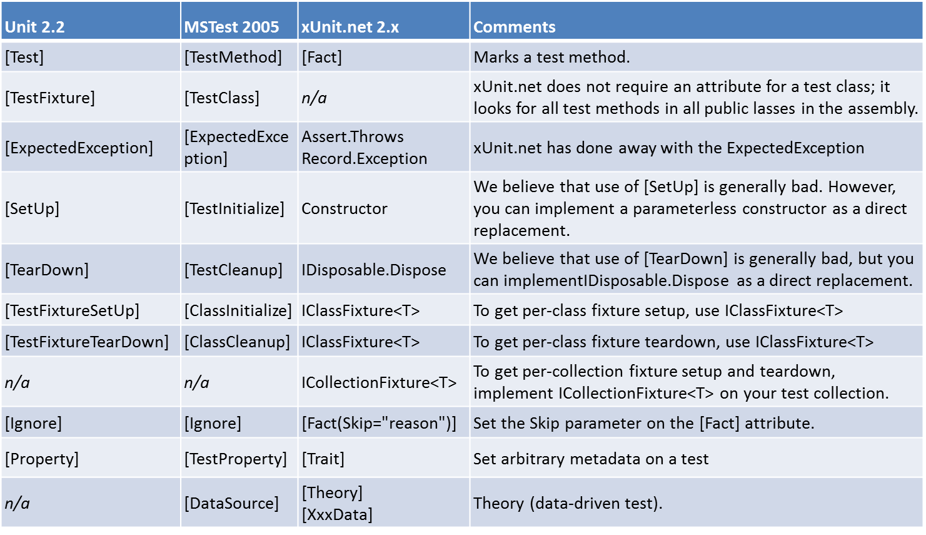
Comparing xUnit.net to other frameworks

Slide 18
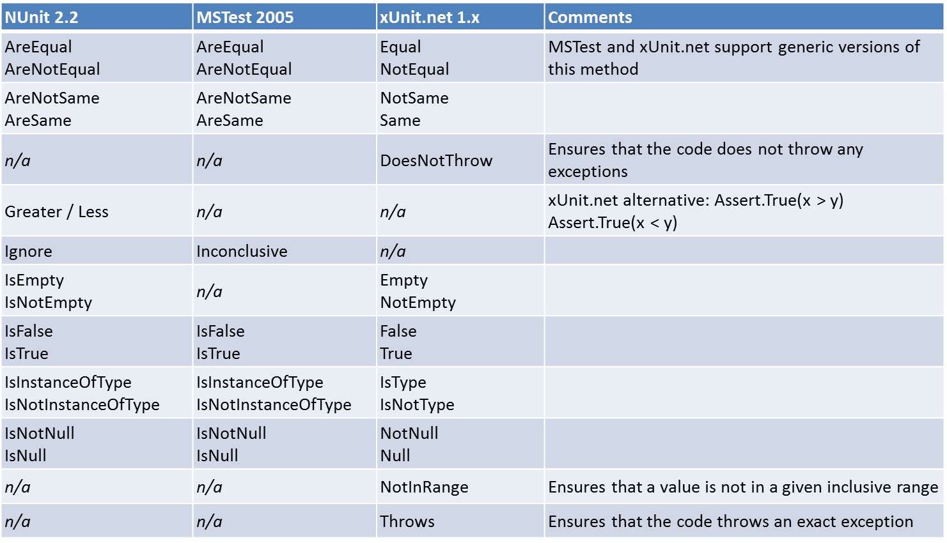
Comparing xUnit.net to other frameworks

