Slide 1
Azure SQL Database Updates
Saranya Ramakrishnan

Slide 2
What is Azure SQL Database?
Advantages of Azure SQL DB
Disadvantages of Azure SQL DB
How does Azure SQL DB differs from SQL Server hosted on VM ?

Slide 3
Latest updates from Azure SQL database
SQL Database Query Editor
Azure SQL Database Threat Detection
Transparent Data Encryption with Azure SQL Database
Setting Up an Elastic Database Pool
Setting Up Dynamic Data Masking

Slide 4
SQL Database Query Editor
Recently, Microsoft has announced the availability of an in-browser query tool that provides an efficient way to execute queries on your Azure SQL Databases and SQL Data Warehouses, without leaving the Azure Portal.
In this editor, we can access and query our database without needing to connect from a client tool or configure firewall rules.

Slide 5
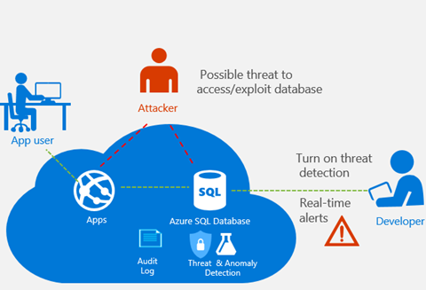
Azure SQL Database Threat Detection
It provides an additional layer of security intelligence built into the Azure SQL Database service.

Slide 6
Transparent Data Encryption with Azure SQL Database
Azure SQL Database TDE helps protect against the threat of malicious activity by performing real-time encryption and decryption of the database, associated backups, and transaction log files at rest without requiring changes to the application.
TDE encrypts the storage of an entire database by using a symmetric key called the database encryption key.
In SQL Database the database encryption key is protected by a built-in server certificate.

Slide 7
Setting Up Dynamic Data Masking
Dynamic data masking limits (DDM) sensitive data exposure by masking it to non-privileged users.
Four types of masks are available.
Default Email Random Custom | Full masking according to the data types of the designated fields. Masking method which exposes the first letter of an email address and the constant suffix ".com", in the form of an email address. A random masking function for use on any numeric type to mask the original value with a random value within a specified range. Masking method which exposes the first and last letters and adds a custom padding string in the middle

Slide 8
Setting Up an Elastic Database Pool
This service allows you to create a pool of database that share the same underlying resource. https://docs.microsoft.com/en-us/azure/sql-database/sql-database-elastic-pool

Slide 9
Thank you !!!!!☺

