Slide 1
Unit Testing with xUnit.net
Kishorekumar

Slide 2
Agenda
What is Xunit.net
Why xUnit.net
Installation
Running Test
Asserts
Data Driven Tests
Comparing xUnit.net with other Frameworks

Slide 3
What is xunit.net
Created in 2007 by 2 ex-Microsofteees
James Newkirk @jamesnewkirk
Brad Wilson @bradwilson
Quick links
http://xunit.github.io
Official web site
https://github.com/xunit
1095 commits, 1336 stars, 57 contributors, 379 forks
https://twitter.com/xunit
2282 followers
https://www.nuget.org/packages/xunit
More than 5M downloads
xUnit.net is a free, open source, community-focused unit testing tool for the .NET Framework. Written by the original inventor of NUnit v2, xUnit.net is the latest technology for unit testing C#, F#, VB.NET and other .NET languages. xUnit.net works with ReSharper, CodeRush, TestDriven.NET and Xamarin. It is part of the .NET Foundation, and operates under their code of conduct. It is licensed under Apache 2 (an OSI approved license).

Slide 4
Design Goals and Features
Multiple Platforms
Parallel Test Execution
Data Driven Tests
Extensible
Nuget Packaging
Separate Assertions

Slide 5
Supported Platforms
Desktop Class Libraries
Portable Class Libraries
Universal Apps (Windows 8.1 & Windows Phone 8.1)
Windows 8 Apps
Windows Phone 8 Apps
Xamarin: MonoAndroid, MonoTouch(iOS Classic), iOS Unified Apps
ASP.NET 5: Windows, Linux, OS X (xUnit2.1)
http://xunit.github.io/#runners

Slide 6
Why xUnit.net?

Slide 7
Lessons learned in Unit Testing (2007)
Write tests using the 3A pattern (Arrange, Act, Assert)
Keep Your Tests Close (to production code)
Use Alternatives to ExpectedException (leads to uncertainty, violates AAA)
Use Small Fixtures (smaller & more focused test classes)
Don’t use SetUp/TearDown, TestInit/TestCleanup, … (improve readability & isolation)
Don’t use abstract base test classes (improve readability & isolation)
Improve testability with Inversion of Control (Better test isolation & decoupled class implementation

Slide 8
xUnit Features
Flexibility: static and private methods
Reduce Friction: fewer attributes
Safety: create a new instance for every test
Be explicit: no control flow in attributes
Runners: be everywhere the developer is
Consistency: Prefer the language & framework
Extensibility: not an afterthought
TDD first: built with and for TDD

Slide 9
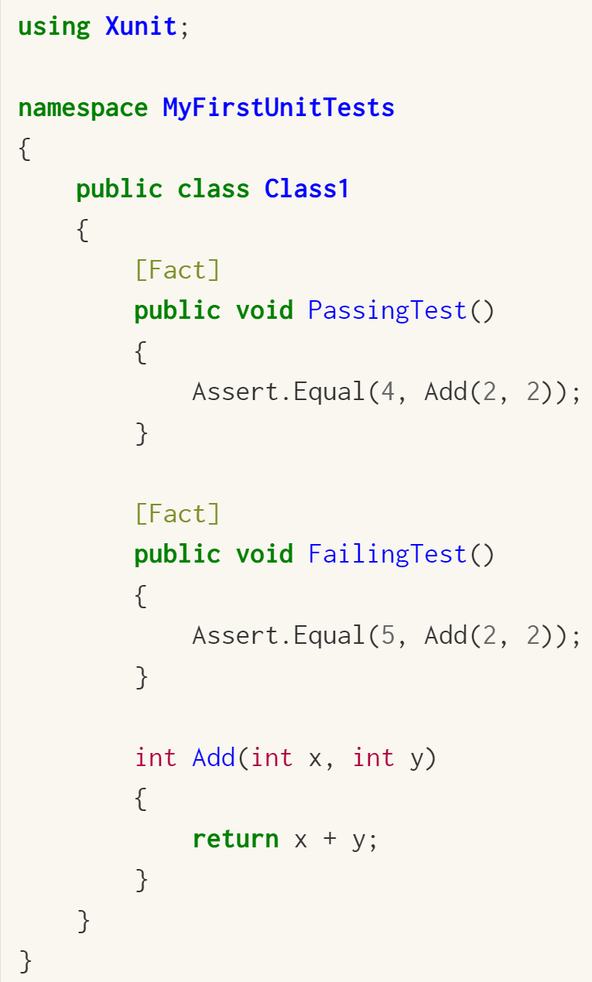
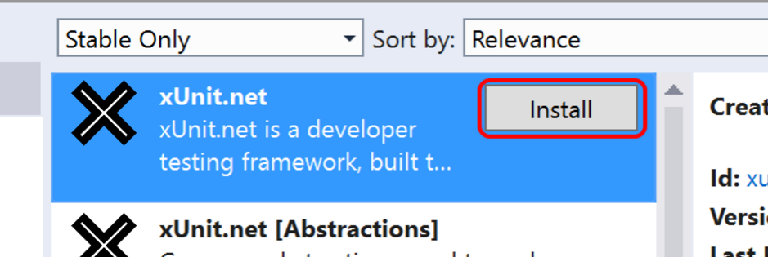
Installation
Getting Started http://xunit.github.io/docs/getting-started.html
Create a class library A test project is just a class library
Add a reference to xUnit.net
Write your first tests
Add a reference to a xUnit.net runner Console or VS

Slide 10
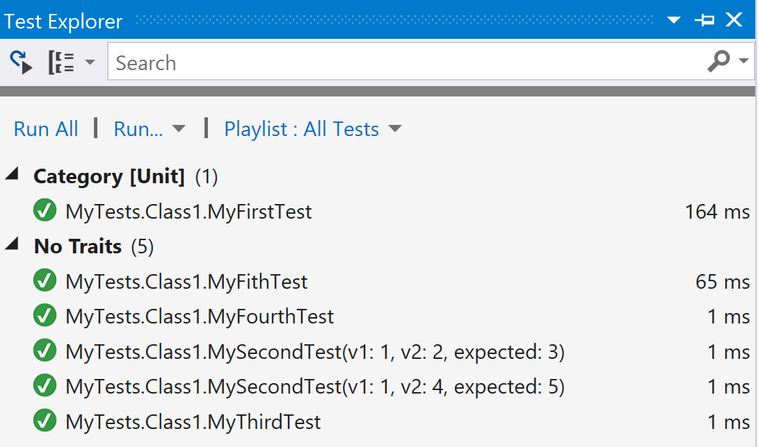
Running Tests
Via Visual Studio Test Explorer
Install-Package
xunit.runner.visualstudio
Via the console test runner
Install-Package xunit.runner.console

Slide 11
Test Discovery and Essential Attributes
Facts are tests which are always true. They test invariant conditions.
Theories are tests which are only true for a particular set of data (Data Driven Tests)

Slide 12
Asserts
Assert: “to state (something) in a strong and definite way” -http://www.merriam-webster.com
Confirm the thing we’re testing behaved as expected
Assert.Equal(expected result, actual result);
How many asserts per test?
Single assert per test
Multiple asserts per test
Assert.Equal
Assert.Null
Assert.Throws

Slide 13
Asserting Test Results
Numeric Values
Assert.Equals
Integer values
Floating point double values
String Values
Simple string equality
Case sensitivity
String contents, starting, ending
Asserting using regular expressions

Slide 14
Asserting Test Results
Null and Boolean Values
True/False Results
Null
Collections
Assert all items in a collection
Collection contain specific item
Collection doesn’t contain an item
Contains an item satisfying a predicate
Collection has all expected items

Slide 15
Asserting Test Results
Exceptions
Asserting that exceptions are thrown
Asserting exception details
Object Types
Asserting exact object types
Asserting derived types

Slide 16
Data Driven Tests
A single test method that can be executed multiple times, each time using a discreet set of test data, with each execution representing an individual case.
Benefits
Reduced test Code Duplication
Reduced Maintenance Cost
Add New test cases More Quickly
External test data Sources

Slide 17
Theory Data Types
InlineData
MemberData
ClassData
ExcelData

Slide 18
Questions ?

