Slide 1
Introduction to Web Assembly
Kishorekumar

Slide 2
Agenda
What is Web Assembly
Evolution of Web Assembly
Web Assembly Structure
What it is for
Roadmap

Slide 3
What is Web Assembly
Web Assembly is a new type of code that can be run in modern web browsers
it is a low-level assembly-like language with a compact binary format that runs with near-native performance and provides languages such as C/C++ with a compilation target so that they can run on the web
It is also designed to run alongside JavaScript, allowing both to work together
New Standard developed by Mozilla, Microsoft, Google and Apple
Fast to load, runs safely
Works on any device

Slide 4
History
Key person: Brendan Eich
1995 – Created JavaScript
1995 - Leading SpiderMonkey
1998 – Started Mozilla
2009 – asm.js Mozilla experiment
2013 – asm.js Published
2013 – Spread asm.js idea to Microsoft
2014-15 – Make other browser vendors to join WebAssembly W3C Group

Slide 5
How JavaScript works in Browser
In programming, there are generally two ways of translating to machine language. You can use an interpreter or a compiler.
With an interpreter, the translation happens pretty much line-by-line, on the fly
A compiler on the other hand doesn’t translate on the fly. It works ahead of time to create that translation and write it down.
Interpreters are quick to get up and running. You don’t have to go through that whole compilation step before you can start running your code. You just start translating that first line and running it
function arraySum(arr) {
var sum = 0;
for (var i = 0; i < arr.length; i++) {
sum += arr[i];
}
}

Slide 6
How JavaScript works in Browser
In a loop, Interpreter have to do the same translation over and over and over again
Compiler takes a little bit more time to start up because it has to go through that compilation step at the beginning. But then code in loops runs faster, because it doesn’t need to repeat the translation for each pass through that loop
Just-in-time compilers: the best of both worlds-As a way of getting rid of the interpreter’s inefficiency—where the interpreter has to keep retranslating the code every time they go through the loop—browsers started mixing compilers in
At first, the JIT-Compiler just runs everything through the interpreter
If the same lines of code are run a few times, that segment of code is called warm. If it’s run a lot, then it’s called hot
Each line of the function is compiled to a “stub”. The stubs are indexed by line number and variable type
When a part of the code is very hot, the monitor will send it off to the optimizing compiler. This will create another, even faster, version of the function that will also be stored

Slide 7
How JavaScript works in Browser
An example optimization: Type specialization
monomorphic - always called with the same types
polymorphic -called with different types from one pass through the code to another
Even with these improvements, though, the performance of JavaScript can be unpredictable. And to make things faster, the JIT has added some overhead during runtime, including:
optimization and deoptimization
memory used for the monitor’s bookkeeping and recovery information for when bailouts happen
memory used to store baseline and optimized versions of a function

Slide 8
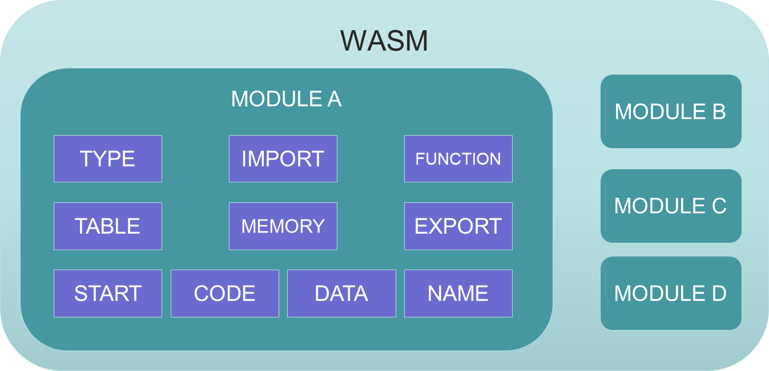
Web Assembly Structure

Slide 9
Sections of Web Assembly
Required:
Type. Contains the function signatures for functions defined in this module and any imported functions.
Function. Gives an index to each function defined in this module.
Code. The actual function bodies for each function in this module.
Optional:
Export. Makes functions, memories, tables, and globals available to other WebAssembly modules and JavaScript. This allows separately-compiled modules to be dynamically linked together. This is WebAssembly’s version of a .dll.
Import. Specifies functions, memories, tables, and globals to import from other WebAssembly modules or JavaScript.
Start. A function that will automatically run when the WebAssembly module is loaded (basically like a main function).
Global. Declares global variables for the module.
Memory. Defines the memory this module will use.

Slide 10
Sections of Web Assembly
Table. Makes it possible to map to values outside of the WebAssembly module, such as JavaScript objects. This is especially useful for allowing indirect function calls.
Data. Initializes imported or local memory.
Element. Initializes an imported or local table.

Slide 11
DEMO https://wasdk.github.io/WasmFiddle/?xk3e1

Slide 12
What it is for
Fill gaps in JavaScript
Develop using language you like
Heavy calculation
Examples:
P2P applications
Image / Video / Music editing
Live video augmentation
Platform simulation
CAD application

Slide 13
Web Assembly is faster than JS
WebAssembly is faster than JavaScript in many cases because:
fetching WebAssembly takes less time because it is more compact than JavaScript, even when compressed.
decoding WebAssembly takes less time than parsing JavaScript.
compiling and optimizing takes less time because WebAssembly is closer to machine code than JavaScript and already has gone through optimization on the server side.
reoptimizing doesn’t need to happen because WebAssembly has types and other information built in, so the JS engine doesn’t need to speculate when it optimizes the way it does with JavaScript.
executing often takes less time because there are fewer compiler tricks and gotchas that the developer needs to know to write consistently performant code, plus WebAssembly’s set of instructions are more ideal for machines.
garbage collection is not required since the memory is managed manually.

Slide 14
RoadMap
Full threading support
SIMD types and intrinsics
Zero-cost exceptions (stack inspection and unwinding)
Coroutines
Dynamic linking
DOM integration
Integrated garbage collection
Tail-call optimization
Multi-process support

