Slide 1
Getting Started With TypeScript
Yothesh

Slide 2
Agenda
What is TypeScript ?
Why TypeScript ?
What is its lifetime ?
TypeScript
TypeScript Compiler
Code Hierarchy
Type Annotations & Inferences
Primitive Types & Object Types
Arrow Functions
Constructors, Properties, Modules
Breaking Angular

Slide 3
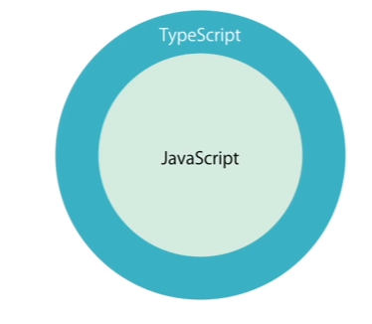
What is TypeScript ?

Slide 4
Why TypeScript ?

Slide 5
Traits of JS

Slide 6
Why TypeScript ?

Slide 7
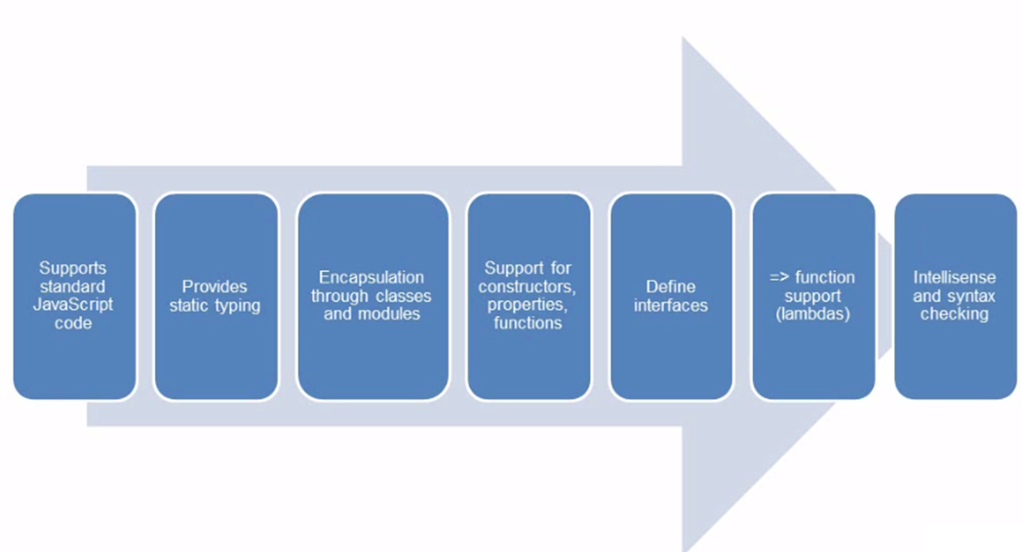
What does TypeScript offer ?

Slide 8
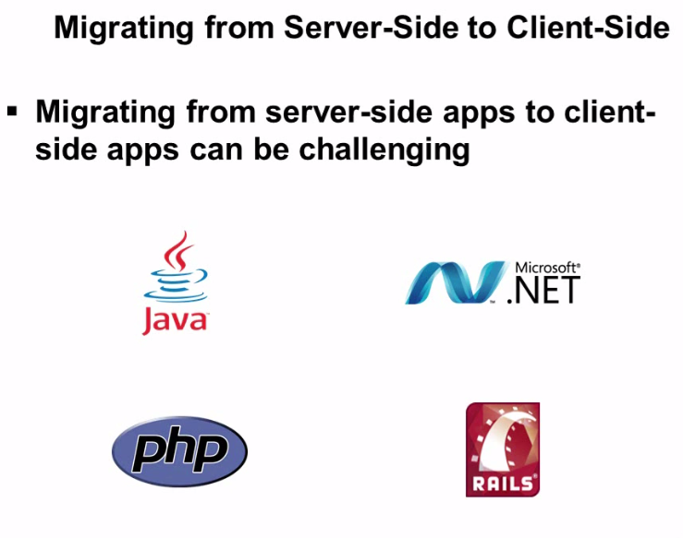
Better than JS ☺

Slide 9
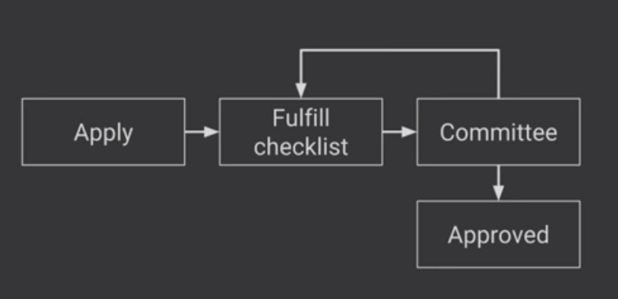
Sanctioning a tech to a stack

Slide 10
Google on TypeScript

Slide 11
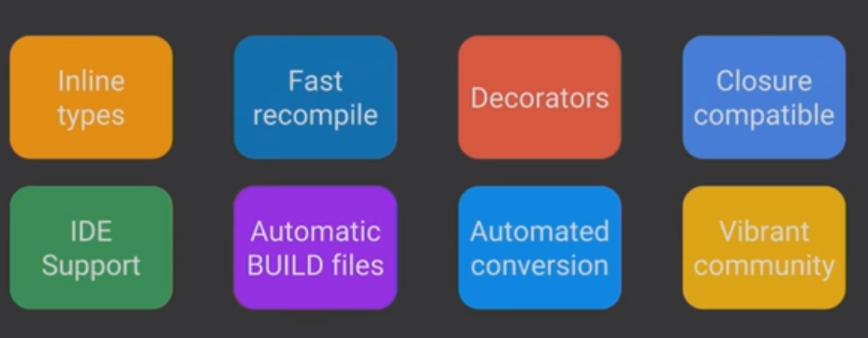
Traits of TS analysed by Google

Slide 12
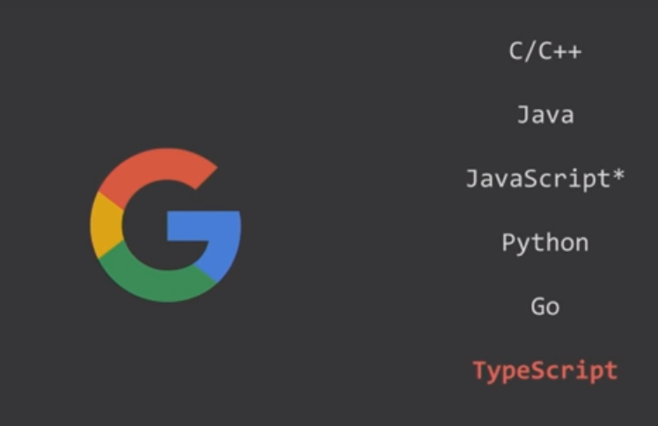
Google <3 TypeScript

Slide 13
TS Alternatives

Slide 14
TS Alternatives

Slide 15
Lets start TS

Slide 16
TS Compiler

Slide 17
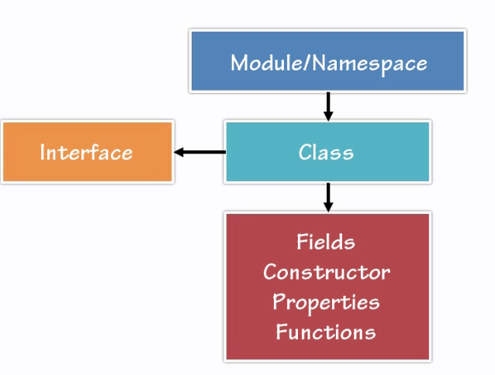
Code Hierarchy

Slide 18
TS Syntax

