Slide 1
Microsoft Power BI with Azure Services
Mekala Ramesh
-Lead QA & Product Support

Slide 2
Agenda
Introduction to Power BI
Azure Audit Log Integration
Azure SQL Database Integration
Web Pages Integration

Slide 3
Business intelligence
Business intelligence (BI) can be described as a set of techniques and tools for the acquisition and transformation of raw data into meaningful and useful information for business analysis purposes
-Wikipedia-

Slide 4
What is Power BI
Power BI is a cloud-based business analytics service that gives you a single view of your most critical business data.
It is collection of
Software Services
Apps
Connectors
Data means
A simple Excel spreadsheet
Collection of cloud-based &
On-Premises hybrid data warehouses
To turn the unrelated sources of data into
Coherent (Logically well organized)
Visually immersive (A 3d image view appears surround the user)
Interactive insights

Slide 5
Cont.,

Slide 6
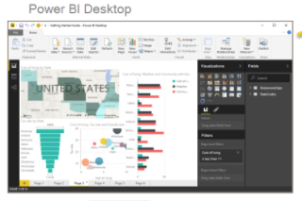
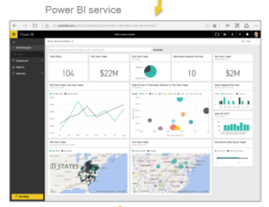
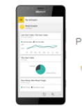
The Parts of Power BI
Power BI is consists of
Power BI Desktop (Windows desktop application)
Power BI Service (An online SaaS)
Power BI Apps (Mobile power BI apps available on windows phones,tablets,IOS & Android devices)
Notes:
After this how power BI matches your role need to be explained.
Power BI desktop – for the extensive reports and share with your team
Power BI services – To pull data from the desktop and push that information to your application using power BI services
Power BI mobile apps – to monitor progress of the sales quotas and to drill into new sales lead details.

Slide 7
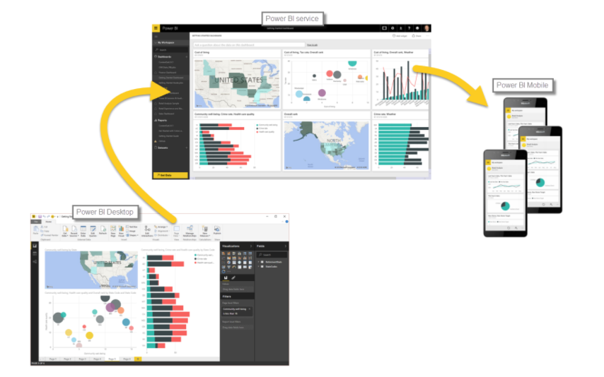
A Flow of Work in Power BI
Publish to power BI service, where you create new visualizations or build dashboards
Bring data into power BI desktop, and create a report
View the shared reports in the power BI mobile apps
Notes:
After this how power BI matches your role need to be explained.
Power BI desktop – for the extensive reports and share with your team
Power BI services – To pull data from the desktop and push that information to your application using power BI services
Power BI mobile apps – to monitor progress of the sales quotas and to drill into new sales lead details.

Slide 8
Integration with Azure Audit Logs
Demo
Notes:
After this how power BI matches your role need to be explained.
Power BI desktop – for the extensive reports and share with your team
Power BI services – To pull data from the desktop and push that information to your application using power BI services
Power BI mobile apps – to monitor progress of the sales quotas and to drill into new sales lead details.

Slide 9
Integration with SQL Database
Demo
Notes:
After this how power BI matches your role need to be explained.
Power BI desktop – for the extensive reports and share with your team
Power BI services – To pull data from the desktop and push that information to your application using power BI services
Power BI mobile apps – to monitor progress of the sales quotas and to drill into new sales lead details.

Slide 10
Integration with Web
Demo
Notes:
After this how power BI matches your role need to be explained.
Power BI desktop – for the extensive reports and share with your team
Power BI services – To pull data from the desktop and push that information to your application using power BI services
Power BI mobile apps – to monitor progress of the sales quotas and to drill into new sales lead details.

Slide 11
Thank you !!!

