Slide 1
New Features of C#
30.03.2017
Kuppurasu Nagaraj

Slide 2
C# Features Highlights
What is new in C# 1.0
  Managed Code
What is new in C# 2.0
  Generics
  Partial types
  Anonymous methods
  Iterators
  Nullable types
  Getter/setter separate accessibility
  Method group conversions (delegates)
  Co- and Contra-variance for delegates
  Static classes
  Delegate inference
What is new in C# 3.0
  Implicitly typed local variables
  Object and collection initializers
  Auto-Implemented properties
  Anonymous types
  Extension methods
  Query expressions
  Lambda expressions
  Expression trees
  Partial Methods
What is new in C# 4.0
  Dynamic binding (late binding)
  Named and optional arguments
  Generic co- and contravariance
  Embedded interop types
What is new in C# 5.0
  Async features
  Caller information
What is new in C# 6.0
  Read-only Auto-properties
  Auto-Property Initializers
  Expression-bodied function members
  using static
  Null - conditional operators
  String Interpolation
  Exception filters
  nameof Expressions
  await in catch and finally blocks
  index initializers
  Extension methods for collection initializers
  Improved overload resolution
What is new in C# 7.0
  out variables
  Tuples
  Pattern Matching
  ref locals and returns
  Local Functions
  More expression-bodied members
  throw Expressions
  Generalized async return types
  Numeric literal syntax improvements

Slide 3
What is new in C# 5.0
What is new in C# 5.0
  Async features
  Caller information

Slide 4
Async features
Introduced in C# 5.0 and Target framework 4.5.
This method can return before it has finished executing.
Any method perform long running task, such as web resource or reading file.
Especially important in graphical program.
VS 2012 onwards support

Slide 5
Async features
The async keyword marks a method for the compiler. The await keyword signals the code to wait for the return of a long running operation.
Creating Asynchronous Methods
There are three approaches to creating asynchronous methods using the new features; each being defined by its return type:
Methods that return void
Methods that return Task
Methods that return Task<T>
public static async void CalculateSumAsync(int i1, int i2)
{
int sum = await Task.Run(() => { return i1 + i2; });
Console.WriteLine("Value: {0}", sum);
}

Slide 6
Rules for use
The following are the rules for use:
The await keyword may not be inserted into a "lock" code block
With try-catch-finally blocks, await may not be used in the catch or finally sections
Async methods may not use "ref" nor "out" parameters
Class constructors may not be marked async nor may they use the await keyword
Await may only be used in methods marked as async
Property accessors may not be marked as async nor may they use await

Slide 7
Caller information
Caller information gives information about the caller of any function.
These three types of attributes that are used in tracking information.
CallerFilePath: Sets the information about caller's source code file.
CallerLineNumber: Sets the information about caller's line number.
CallerMemberName: Sets the information about caller member name.

Slide 8
Caller information
namespace CallerInformation
{
public class CallerInfoDemo
{
public static void Main()
{
ShowCallerInfo();
Console.ReadKey();
}
public static void ShowCallerInfo([CallerMemberName] string callerName = null, [CallerFilePath] string callerFilePath = null, [CallerLineNumber] int callerLine = -1)
{
Console.WriteLine("Caller Name: {0}", callerName);
Console.WriteLine("Caller FilePath: {0}", callerFilePath);
Console.WriteLine("Caller Line number: {0}", callerLine);
}
}
}

Slide 9
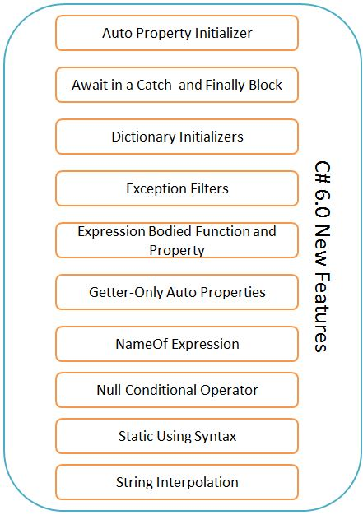
What is new in C# 6.0
  Read-only Auto-properties
  Auto-Property Initializers
  index initializers
  nameof Expressions
  using static
  Exception filters
  await in catch and finally blocks
  Null - conditional operators
  Expression-bodied function members
  String Interpolation

Slide 10
Read-only Auto-properties
Read-only auto-properties provide a more concise syntax to create immutable types.
Earlier versions of C#
C# 6.0
public string FirstName { get; private set; }
public string LastName { get; private set; }
public string FirstName { get; }
public string LastName { get; }

Slide 11
Auto property initializer
Auto property initializer is a new concept to set the value of a property during of property declaration
In C# 5.0
class Employee
{
public Employee()
{
Name = "Ram";
Age = 25;
Salary = 10000;
}
public string Name { get; set; }
public int Age { get; set; }
public int Salary { get; private set; }
}
In C# 6.0
class Employee
{
public string Name { get; set; } = "Ram";
public int Age { get; set; } = 25;
public int Salary { get; private set; } = 10000;
}

Slide 12
Index Initializers
We can directly initialize a value of a key in a Dictionary Collection by “=“ Operator
In C# 5.0
In C# 6.0
Dictionary<int, string> dicInt = new Dictionary<int, string>()
{
{1,"Chennai"},
{2,"Madurai"},
{3,"Coimbatore"},
};
dicInt[4] = "Salem";
foreach (var item in dicInt)
{
Console.WriteLine(item.Key + " " + item.Value);
}
Dictionary<int, string> dicInt = new Dictionary<int, string>()
{
[1] = "Chennai",
[2] = "Madurai",
[3] = "Coimbatore"
};
dicInt[4] = "Salem";
foreach (var item in dicInt)
{
Console.WriteLine(item.Key + " " + item.Value);
}

Slide 13
Name of Expression
class Employee
{
public string Name { get; set; } = "Ram";
public int Age { get; set; } = 25;
public int Salary { get; private set; } = 10000;
}
class Program
{
static void Main(string[] args)
{
Employee emp = new Employee();
WriteLine("{0} : {1}", nameof(Employee.Name), emp.Name);
WriteLine("{0} : {1}", nameof(Employee.Age), emp.Age);
WriteLine("{0} : {1}", nameof(Employee.Salary), emp.Salary);
ReadLine();
}
}

Slide 14
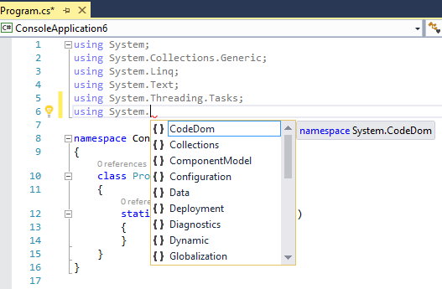
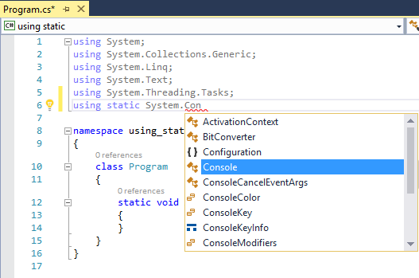
using static
In C# 5.0
In C# 6.0

Slide 15
Exception filters
Exception filters allow us to specify a condition with a catch block so if the condition will return true then the catch block is executed only if the condition is satisfied.
class Program
{
static void Main(string[] args)
{
int val1 = 0;
int val2 = 0;
try
{
WriteLine("Enter first value :");
val1 = int.Parse(ReadLine());
WriteLine("Enter Next value :");
val2 = int.Parse(ReadLine());
WriteLine("Div : {0}", (val1 / val2));
}
catch (Exception ex) when (val2 == 0)
{
WriteLine("Can't be Division by zero ☺");
}
catch (Exception ex)
{
WriteLine(ex.Message);
}
Console.ReadLine();
}
}

Slide 16
Await in catch and finally block
public class MyMath
{
public async void Div(int value1, int value2)
{
try
{
int res = value1 / value2;
WriteLine("Div : {0}", res);
}
catch (Exception ex)
{
await asyncMethodForCatch();
}
finally
{
await asyncMethodForFinally();
}
}
private async Task asyncMethodForFinally()
{
WriteLine("Method from async finally Method !!");
}
private async Task asyncMethodForCatch()
{
WriteLine("Method from async Catch Method !!");
}

Slide 17
Null-Conditional Operator
Reducing lines of code
Null conditional operator (?.)
if (response != null && response.Results != null && response.Results.Status == Status.Success)
{
Console.WriteLine("We were successful!");
}
if (response?.Results?.Status == Status.Success)
{
Console.WriteLine("We were successful!");
}

Slide 18
Expression–Bodied Methods
class Program
{
static void Main(string[] args)
{
WriteLine(GetTime());
ReadLine();
}
public static string GetTime()
{
return "Current Time - " + DateTime.Now.ToString("hh:mm:ss");
}
}
class Program
{
static void Main(string[] args)
{
WriteLine(GetTime());
ReadLine();
}
public static string GetTime() => "Current Time - " + DateTime.Now.ToString("hh:mm:ss");
}
}

Slide 19
String Interpolation
static void Main(string[] args)
{
string FirstName = "Kuppurasu";
string LastName = "Nagaraj";
string output = String.Format("{0} - {1}", FirstName, LastName);
WriteLine(output);
ReadLine();
}
static void Main(string[] args)
{
string FirstName = "Kuppurasu";
string LastName = "Nagaraj";
string output = $"{FirstName} - {LastName}";
WriteLine(output);
ReadLine();
}

Slide 20
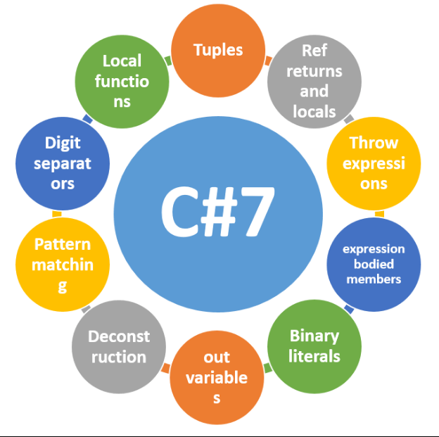
What is new in C# 7.0
  out variables
  Tuples
  Pattern Matching
  ref locals and returns
  Local Functions
  More expression-bodied members
  throw Expressions
  Generalized async return types
  Numeric literal syntax improvements
  Non-nullable reference types

Slide 21
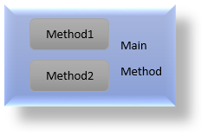
Local Functions
This is the ability to declare methods and types in your block scope.
static void Main()
{
string GetAgeGroup(int age)
{
if (age < 10)
return "Child";
else if (age < 50)
return "Adult";
else
return "Old";
}
Console.WriteLine("My age group is {0}", GetAgeGroup(33));
Console.ReadKey();
}
Notes:
Many designs for classes include methods that are called from only one location.
These additional private methods keep each method small and focused.
It easier for readers of the class to see that the local method is only called from the context in which is it declared.

Slide 22
Binary Literals
public const int One = 0b0001;
public const int Two = 0b0010;
public const int Four = 0b0100;
public const int Eight = 0b1000;

Slide 23
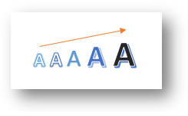
Numeric literal syntax improvements
int bin = 0b1001_1010_0001_0100;
int hex = 0x1b_a0_44_fe;
int dec = 33_554_432;
int weird = 100_000;
double real = 1_000.111_1e-1_000;

Slide 24

Pattern Matching
In C# 7.0 , patterns are applied to the two existing language feature that includes
is expression
switch statement

Slide 25
is expression
static void Main(string[] args)
{
dynamic input = null;
Demo1(input);
input = "Kuppu";
Demo1(input);
Console.ReadLine();
}
public static void Demo1(object input)
{
if (input is null)
Console.WriteLine("Null Value");
// Check if the input is of type string , if yes , extract the value to tempStr
if (input is string tempStr)
Console.WriteLine(tempStr);
}

Slide 26
switch statement
int powerUnits = 150;
//object powerUnits = "150";
switch (powerUnits)
{
case int i when i > 100:
WriteLine("Sufficient power units.");
break;
case int i:
WriteLine("Insufficient power units.");
break;
default:
WriteLine("Unknown power units.");
break;
}

Slide 27

Non-nullable reference types
int a; //non-nullable value type
int? b; //nullable value type
string! c; //non-nullable reference type
string d; //nullable reference type
MyClass a; // Nullable reference type
MyClass! b; // Non-nullable reference type
a = null; // OK, this is nullable
b = null; // Error, b is non-nullable
b = a; // Error, a might be null, b can't be null

Slide 28
More expression-bodied members
In C# 7, you can implement constructors, finalizers, and get and set accessors on properties and indexers.
public class ExpressionMembersExample
{
// Expression-bodied constructor
public ExpressionMembersExample(string label) => this.Label = label;
// Expression-bodied finalizer
~ExpressionMembersExample() => Console.Error.WriteLine("Finalized!");
private string label;
// Expression-bodied get / set accessors.
public string Label
{
get => label;
set => this.label = value ?? "Default label";
}
}

Slide 29
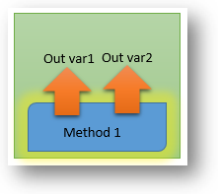
out variables
static void Main(string[] args)
{
string firstName;
string lastName;
CreateName(out firstName, out lastName);
Console.WriteLine($"Hello {firstName} {lastName}");
}
static void Main(string[] args)
{
CreateName(out string firstName, out string lastName);
Console.WriteLine($"Hello {firstName} {lastName}");
}
Notes:
The most common reason for grouping up of temporary variables is to return multiple values from a method.

Slide 30

Throw Exception from Expression
In C# 7, we can throw an exception directly through expression. Thus, an exception can be thrown from an expression.
class Program
{
static void Main(string[] args)
{
var a = Divide(10, 0);
}
public static double Divide(int x, int y)
{
return y != 0 ? x % y : throw new DivideByZeroException();
}
}

Slide 31
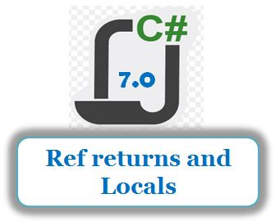
Ref locals and returns
private static ref int GetBiggerNumber(ref int num1, ref int num2)
{
ref int localVariable = ref num1;
if (num1 > num2)
return ref num1;
else
return ref num2;
}

Slide 32

Tubles
A tuple allows us to combine multiple values of possibly different types into a single object
without having to create a custom class.
//types of struct members are automatically inferred by the compiler as string,string
var genders = ("Male", "Female");
Console.WriteLine("Possible genders in human race are : {0} and {1} ", genders.Item1, genders.Item2);
Console.WriteLine($"Possible genders in human race are {genders.Item1}, {genders.Item2}.");
//hetrogeneous data types are also possible in tuple.
var employeeDetail = ("Michael", 33, true); //(string,int,bool)
Console.WriteLine("Details of employee are Name: {0}, Age : {1}, IsPermanent: {2} ", employeeDetail.Item1, employeeDetail.Item2, employeeDetail.Item3);
Notes:
C# provides a rich syntax used for classes and structs provides to explain your design intent.
But sometimes that rich syntax requires extra work with minimal benefit.

