Slide 1
“Introduction to Azure Security Center”
Kuppurasu
Notes:
Security Center helps us prevent, detect, and respond to threats with increased visibility into and control over the security of our Azure resources.
It provides integrated security monitoring and policy management across your Azure subscriptions.

Slide 2
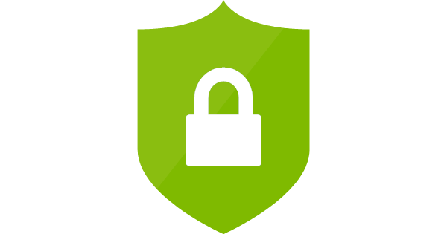
Agenda
What is Azure Security Center?
Configure Security Policy
Recommendations
Understand our Security Health
Get Alerted to Security Threats
Demo

Slide 3
What is Azure Security Centre?
Understand the security state of all of our Azure resources
Take control of cloud security with policy-driven monitoring of security configurations
Make it easy for DevOps to deploy integrated Microsoft and partner security solutions
Find threats with behavioral analysis based on our global intelligence and expertise
Respond to incidents quickly with insights into attacks and suggestions for remediation

Slide 4
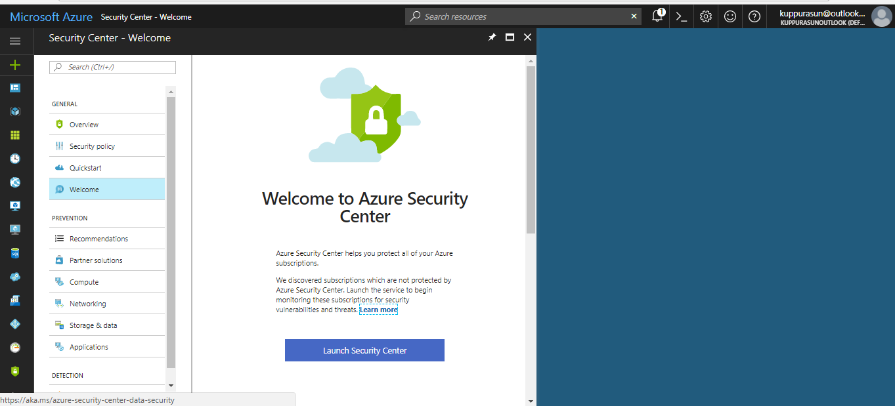
Demo

Slide 5
Configure Security Policy
Customize the security policy for your Azure subscriptions according to our company security needs and the type of applications or sensitivity of data.
Enable automatic collection of security configurations and logs for analysis and choose the security controls you want to monitor and recommend.

Slide 6
What are security policies?
A security policy defines the set of controls, which are recommended for resources within the specified subscription.
The Security policy blade for the selected subscription opens with a set of options.
Prevention policy: Use this option to configure policies per subscription.
Email notification: Use this option to configure an email notification that's sent on the first daily occurrence of an alert and for high severity alerts.
Pricing tier: Use this option to upgrade the pricing tier selection.

Slide 7
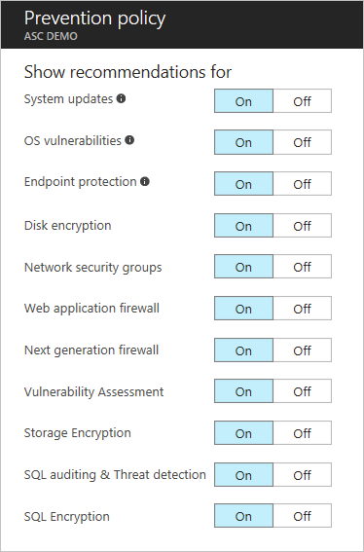
Prevention policy

Slide 8
Complete Recommendations
View a list of security recommendations, such as enabling Endpoint Protection on virtual machines, defining a Network Security Group for subnets and network interfaces, applying encryption for SQL databases and more.
Notes:
Security Center periodically analyzes the security state of your Azure resources. When Security Center identifies potential security vulnerabilities, it creates recommendations. The recommendations guide you through the process of configuring the needed controls.

Slide 9
Recommendations

Slide 10
Understand our Security Health
View the security state of all your Azure resources, including your virtual machines, networks, SQL databases and more.

Slide 11
Get Alerted to Security Threats
Access a prioritized list of alerts detected through analysis of network traffic and virtual machine behavior, along with alerts from integrated partner solutions.

Slide 12
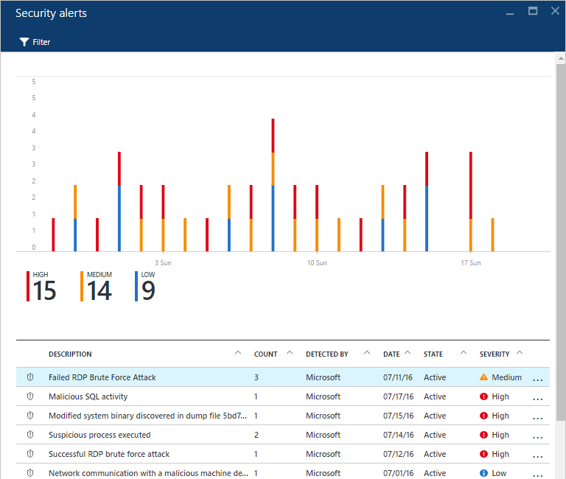
Get Alerted to Security Threats

Slide 13
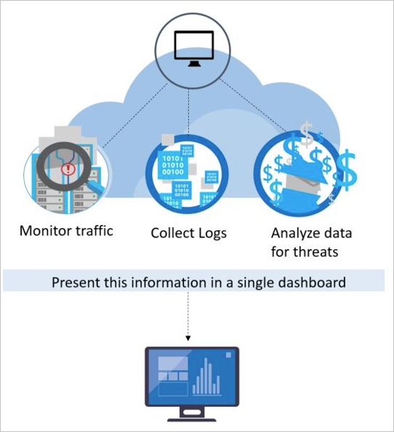
How Azure Security Center detects and responds to threats

Slide 14
Get insights from Azure Security Center data with Power BI
We can choose to explore our security status in 2 different Power BI Dashboards:
1. Security insights dashboard
Explore your security status, threats and detections across subscriptions
2. Policy management dashboard
Explore management and enforcement of policy across subscriptions, and find subscriptions who don't meet policy.

