Slide 2
Agenda
Brief Introduction To Support Process
Understanding the customer problems
Root cause analysis
Troubleshooting tools
Different test scenarios
Soft skills

Slide 3
Brief Introduction to support process
The support team
Support process
Escalations
Handing of support tickets

Slide 4
Understanding the Customer problems
Not Reading between the lines
Asking Open ended questions
Identifying the scenarios
Understanding the setup
Avoiding repeated questions

Slide 5
Root cause analysis
Log Information
Trace files
Database reports
Data Volume
UI related issues

Slide 6
Troubleshooting tools
Windows tools
Assist documents
Troubleshooter
Log information

Slide 7
Developing different test scenarios
Unit test cases
Functional test cases
Regression Test cases
JIRA tickets
Spellings and messages

Slide 8
Support tickets
BHM Event log error for SYSADMIN permission
- This is from BHMv4.0
FTP monitoring remote configuration
- This is when proxy settings is used
Email Template – service instance detail missing
Upgrade scenarios with multiple environments
- At least two environments with ESB configured
Intermittently occurring issues
- Group by results duplicate filter in MBQ

Slide 9
Support Tickets Contd.
Analytics config file missing
Integrated Troubleshooter in Windows 2016 machine
Throttling data collection error

Slide 10
Soft Skills development
Skills, abilities and traits that pertain to personality, attitude, and behavior.
Not Formal or Technical knowledge.
The Hardest to acquire…Impossible to practice…Unless they become habits

Slide 11
Types of Soft skills
Ability to work in a team structure.
Ability to make decisions and solve problems.
Ability to communicate verbally with people inside and outside an organization.
Ability to plan, organize, and prioritize work.
Ability to obtain and process information.

Slide 12
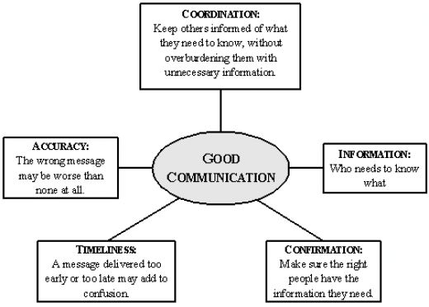
Communication

Slide 13
Team work
Behind every successful project is a successful team.
Built on communication, behavior and delivery.
It mainly refers to the agreeableness & co-operation among the team members.
Too often, egos and politics get in the way…but be a strong team player.
It requires trust, cooperation, clarity regarding goals and communication.

Slide 14
Good Basic Life Lessons
You are responsible for yourself.
What you don’t know may hurt you, or hold you back.
Don’t be afraid of something. Learn about it!
Build on your strengths; target weaknesses.
Develop important soft skills.
Technical competency is the core of your career in engineering!

