Slide 1
Fundamentals 02.03.2017
Sunny Sharma
Microsoft MVP
@sunny_delhi

Slide 2
Agenda
What is Docker?
How Docker works?
Basic Terms
Where to get started?

Slide 3
Docker
A tool designed to make it easier to create, deploy, and run applications by using Containers. Containers allow a developer to package up an application with all of the parts it needs, such as libraries and other dependencies, and ship it all out as one package.
Initial Release: 13th March 2013

Slide 4
Docker
Is a Fancy way to run a process, not a virtual machine.
Containers run in a Shared Environment
Reduced Scale time
Reduced resource consumption
A VM, without overhead of the VM

Slide 5
Docker

Slide 6
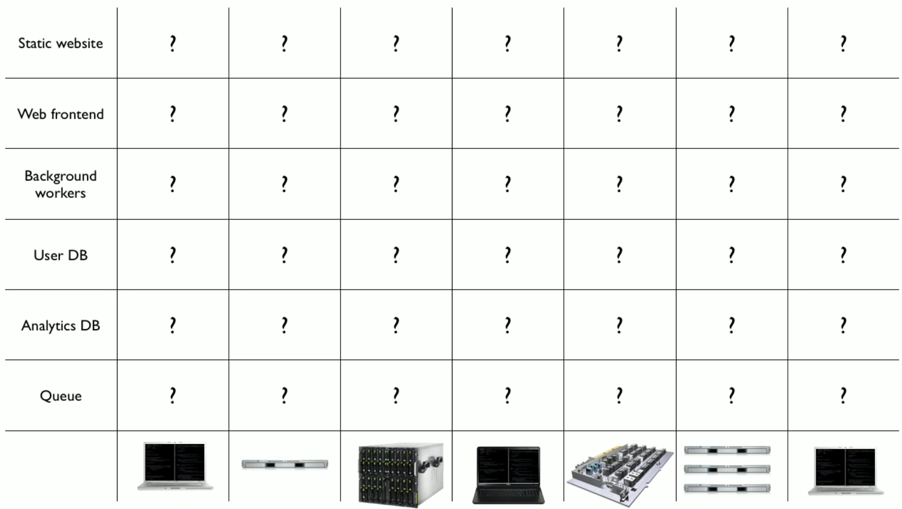
Docker

Slide 7
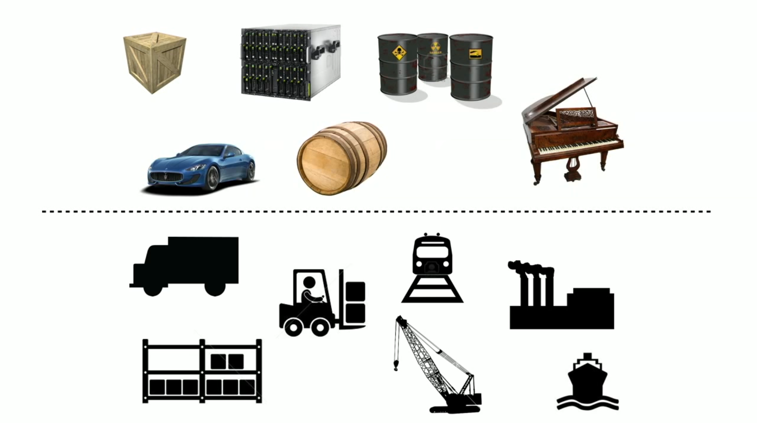
Docker

Slide 8
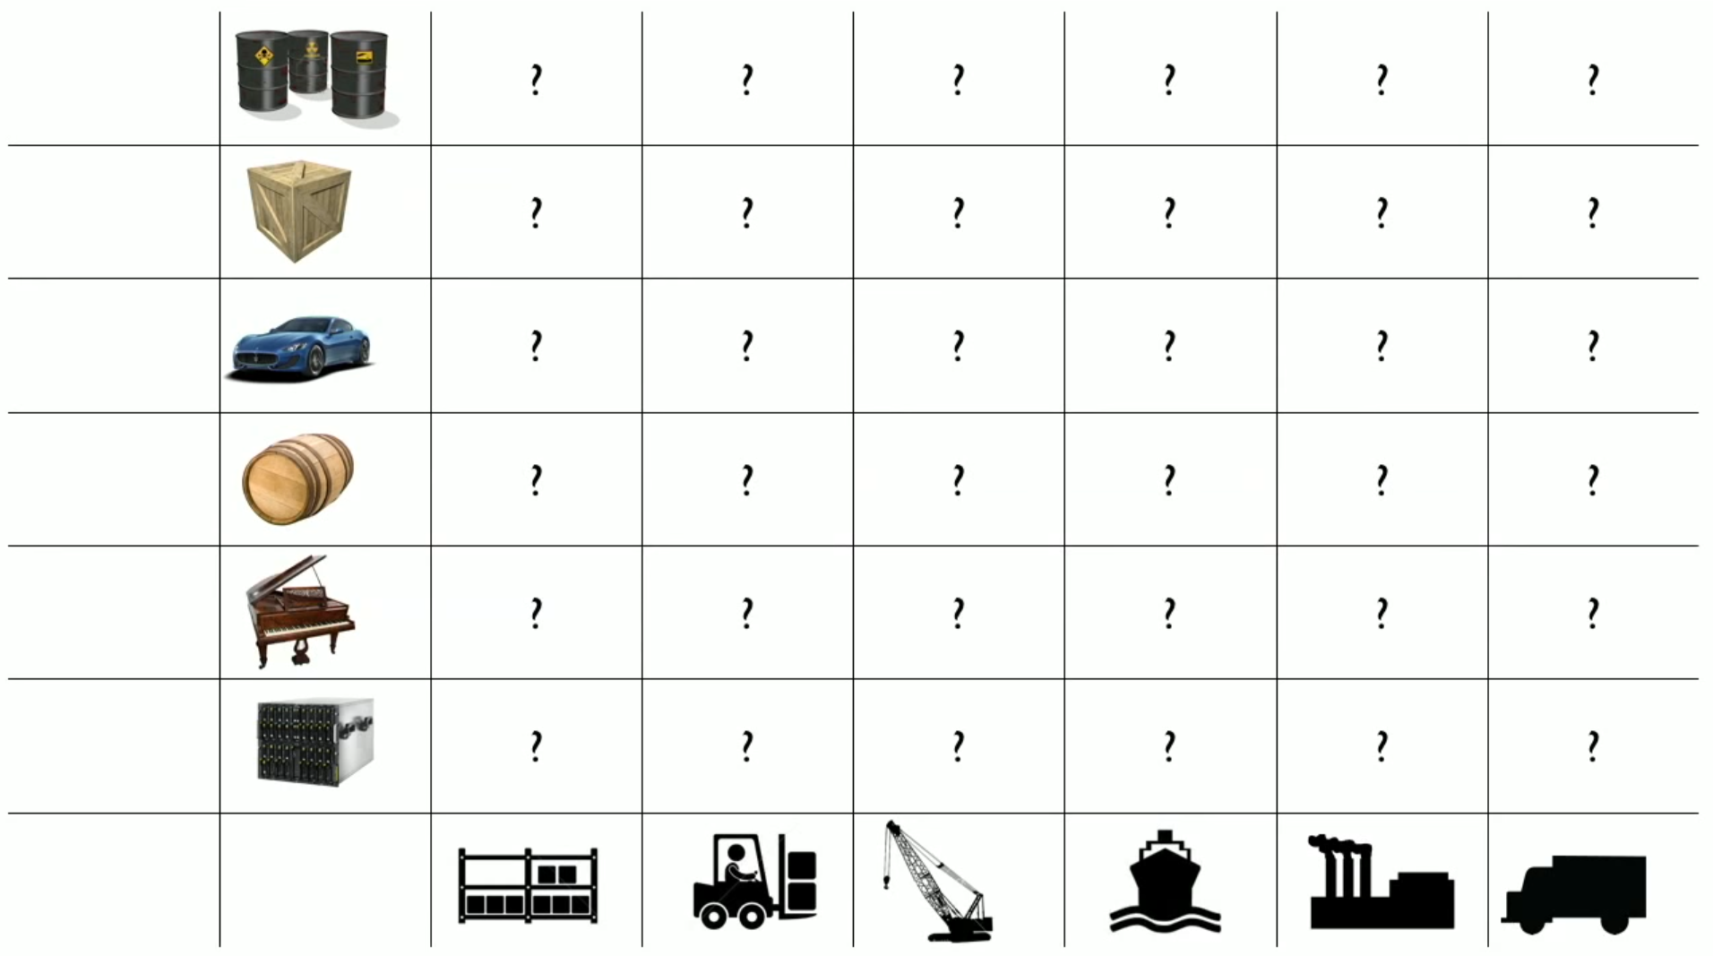
Docker

Slide 9
Docker

Slide 10
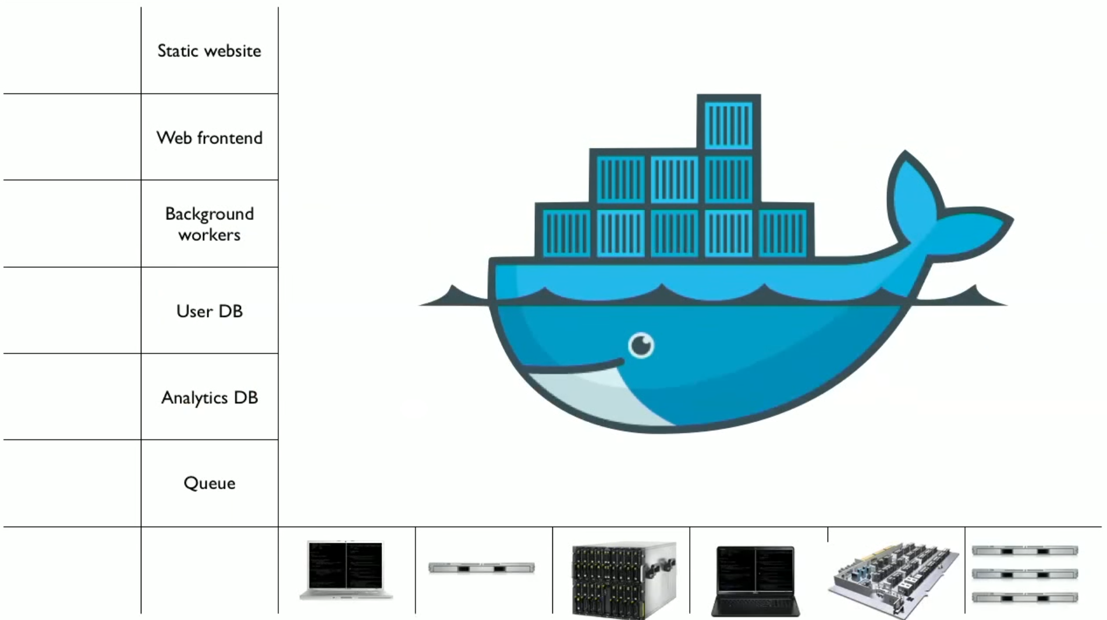
Docker

Slide 11
Docker – Basic Terms
Docker Engine
The Docker project as a whole, which is a platform for developers and sysadmins to develop, ship, and run applications
The docker daemon process running on the host which manages images and containers
Docker Engine = Docker Deamon + Docker CLI

Slide 12
Docker – Basic Terms
Container
A container is a runtime instance of a docker image
A Docker container consists of
A Docker image
Execution environment
A standard set of instructions

Slide 13
Docker – Basic Terms
Node
A node is an instance of the Docker engine participating in the swarm

Slide 14
Docker – Basic Terms
Swarm
A swarm is a cluster of Docker engines, or nodes, where you deploy services.

Slide 15
Docker – Basic Terms
Docker For Mac
Docker development environment designed specifically for the Mac.
Native Mac application, uses macOS Hypervisor framework, networking and filesystem.
Best solution if you want to build, debug, test, package, and ship Dockerized applications on a Mac.

Slide 16
Docker – Basic Terms
Docker For Windows
Docker development environment designed specifically for Windows 10 systems that support Microsoft Hyper-V.
It works with Windows Server 2016, and gives you the ability to set up and run Windows containers as well as the standard Linux containers, with an option to switch between the two.

Slide 17
Docker – Basic Terms
Docker Hub
Docker Hub is a cloud hosted service from Docker that provides registry capabilities for public and private content

Slide 18
Docker – Basic Terms
Docker Registry
A Registry is a hosted service containing repositories of docker images
The default registry can be accessed using a browser at Docker Hub or using the docker search command

Slide 19
Docker – Basic Terms
Docker Image
A union of layered filesystems stacked on top of each other.
An image does not have state and it never changes

Slide 20
Docker – Basic Terms
Docker File
A text document that contains all the commands you would normally execute manually in order to build a Docker image
Docker can build images automatically by reading the instructions from a Dockerfile

Slide 21
Virtualization
In its conceived form, it was considered a method of logically dividing mainframes to allow multiple applications to run simultaneously.
Evolved gradually with the support of companies and open source communities to allow for multiple OS to be run simultaneously.

Slide 22
Hypervisor
Handles creating the virtual environment on which the Guest OS operate.
Makes sure that resources are allocated to the guests as necessary.
Sits in between the physical machine and virtual machines and provides virtualization services to the virtual machines.
it intercepts the guest operating system operations on the virtual machines and emulates the operation on the host machine's operating system

Slide 23
Types of Virtualization
The virtualization method can be categorized based on how it mimics hardware to a guest operating system and emulates guest operating environment. Primarily, there are three types of virtualization:
Emulation
Paravirtualization
Container-based virtualization

Slide 24
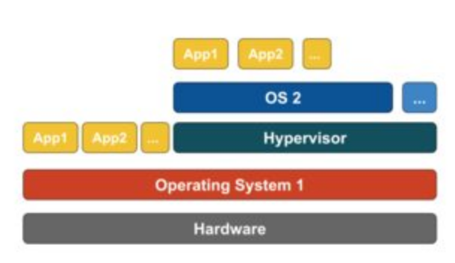
Types of Virtualization - Emulation
Known as Full Virtualization, Type-2 Hypervisor
Is installed on the top of host operating system
Responsible for translating guest OS kernel code to software instructions
The translation is done entirely in software and requires no hardware involvement
Example: Vmware Player, VirtualBox, QEMU, Parallels etc.

Slide 25
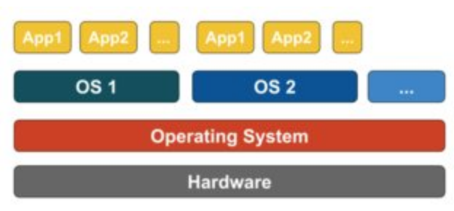
Types of Virtualization - Paravirtualization
Runs directly on the hardware, or “bare-metal”, Type-1 Hypervisor.
Helps the operating system, the virtualized hardware, and the real hardware to collaborate to achieve optimal performance
Example: Xen, KVM

Slide 26
Types of Virtualization – Container Based V.
Known as OS-Level Virtualization
Enables multiple isolated executions with a Single OS Kernel
Offers the Best Performance
Can be viewed as a traced group of processes.
Example: Docker, Kubernetes etc.

Slide 27
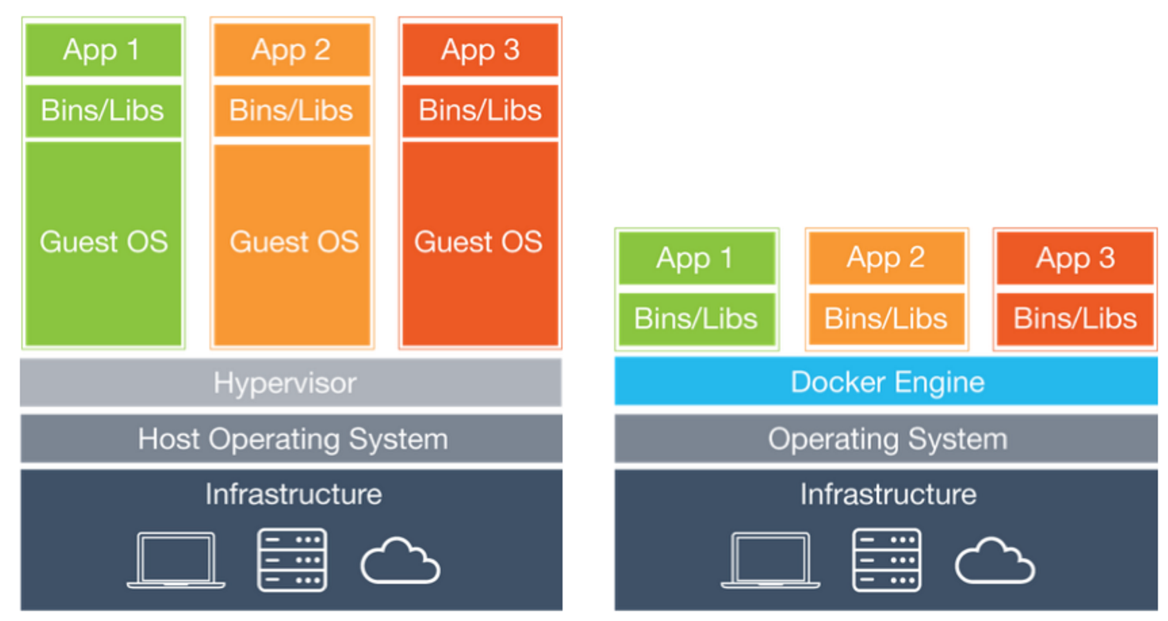
Docker – Containers vs. VMs
Virtual Machine
Docker

Slide 28
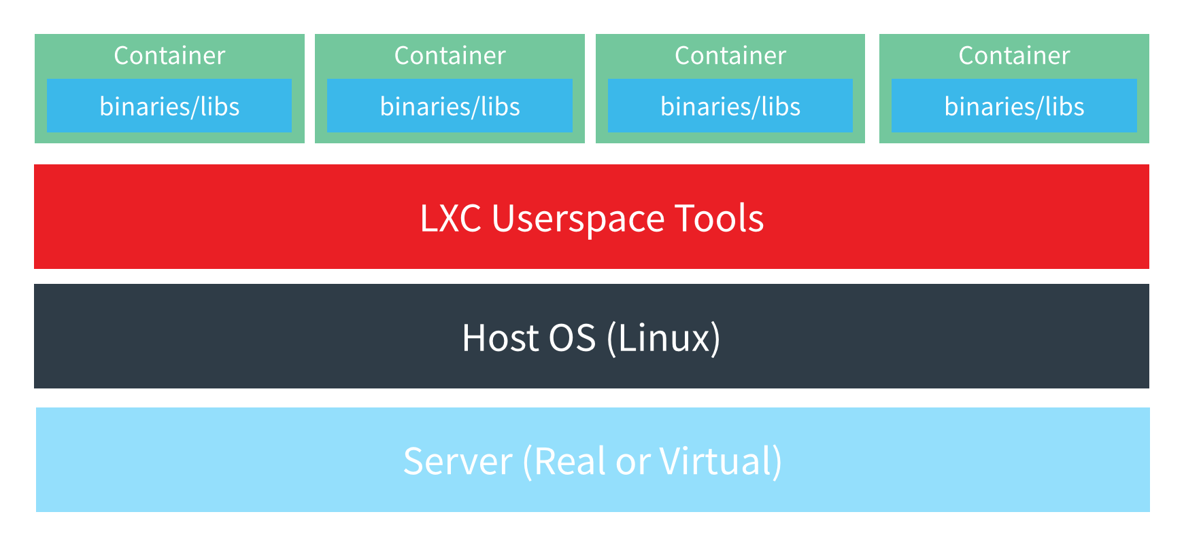
Docker – Containers
You cannot run a windows container on a Linux host because there is no Linux Kernel support for windows

Slide 29
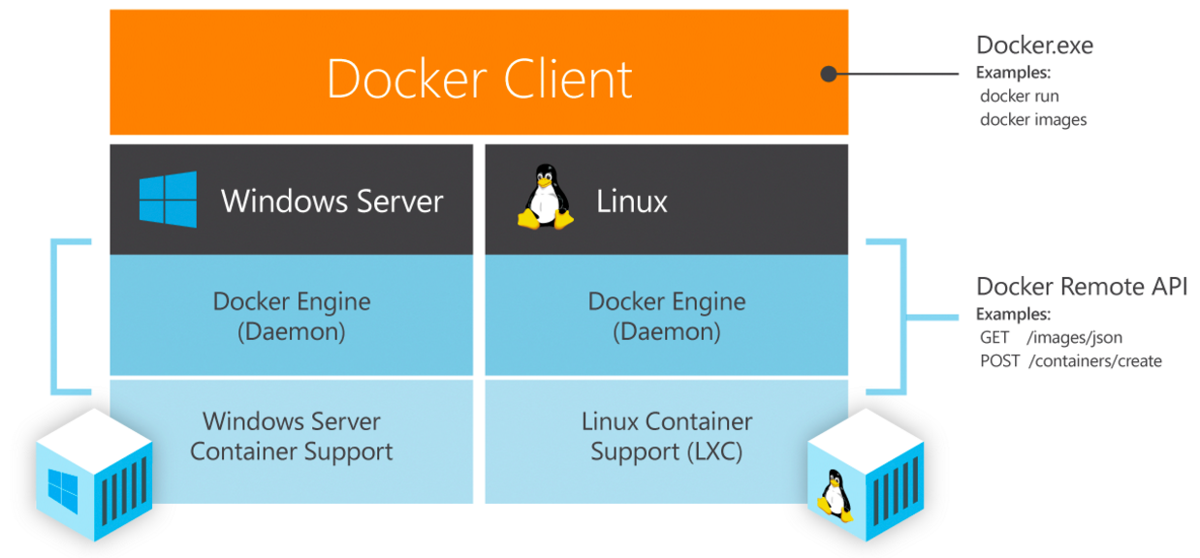
Docker – Native Support

Slide 30
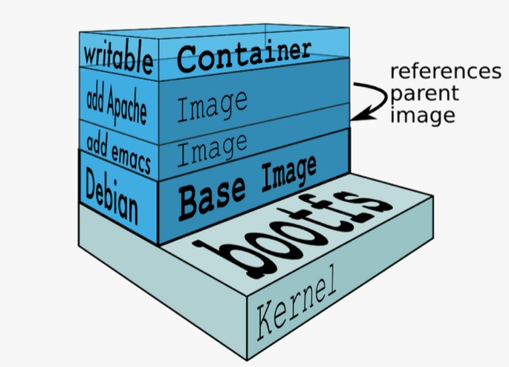
Docker – Platform workflow

Slide 31
Docker – Platform workflow
Find an Image on Docker Hub
Pull an Image from Docker Hub
Run an Image on Docker Host
Stop an Instance
Remove an Instance
Remove an Image

Slide 32
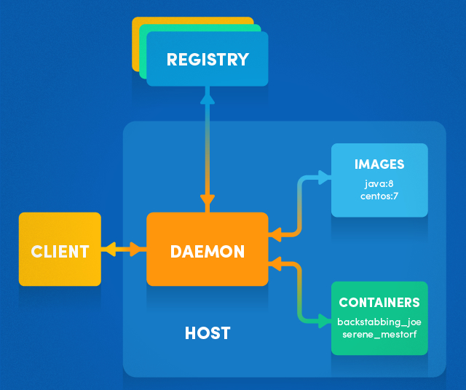
Docker – How it works?

Slide 33
Docker File
# Sample Dockerfile
# Indicates that the windowsservercore image will be used as the base image.
FROM microsoft/windowsservercore
# Metadata indicating an image maintainer.
MAINTAINER jshelton@contoso.com
# Uses dism.exe to install the IIS role.
RUN dism.exe /online /enable-feature /all /featurename:iis-webserver /NoRestart
# Creates an HTML file and adds content to this file.
RUN echo "Hello World - Dockerfile" > c:\inetpub\wwwroot\index.html
# Sets a command or process that will run each time a container is run from the new image.
CMD [ "cmd" ]

Slide 34
Docker – Where to get started?
https://training.docker.com - Free self-paced courses
https://docs.docker.com/engine/getstarted/ - Docker Reference
https://hackr.io/tutorials/learn-docker - Free Video Tutorials
https://www.pluralsight.com - Pluralsight
https://www.mva.microsoft.com – Microsoft Virtual Academy

Slide 35
Questions?

Slide 36
Thank You! ☺
Image credits: Various Internet References

