Slide 1
Building a Continuous Integration Pipeline using VSTS
Sunny Sharma
Microsoft MVP, Senior Software Engineer

Slide 2
Agenda:
Discuss CI/CD
Create Build Pipeline
Create a Release Pipeline
Notes:
Build Pipeline
VSTS Build Agents
Third Party Build tools
Release Pipeline
Hands-on demo

Slide 3
Notes:
Build Pipeline
VSTS Build Agents
Third Party Build tools
Release Pipeline
Hands-on demo

Slide 4
Continuous Integration (CI)
the practice of constantly merging development work with a Master codebase… so that you can test changes, and test that those changes work with other changes.

Slide 5
Continuous Delivery (CD)
the continual delivery of code to an environment once the developer feels the code is ready to deploy - this could be UAT, staging or production.

Slide 6
Continuous Deployment (CD)
Continuous Delivery – with Auto-Approval

Slide 7
Continuous Delivery
Automated build on every change to the branch
Automated deploy on every successful build
Continuous Integration Services
Version Control
Build
Deploy
Commit
On change
On Build
Scheduled Daily
Manual

Slide 8
Continuous Delivery
Automated build on every change to the branch
Automated deploy on every successful build
Continuous Integration Services
Version Control
Build
Deploy
Repository
Branches
Workflow
Policies
Roles
Build Def
Build agent
Build tasks
Test tasks
Analysis
Packaging
Release Def
Target host
Svc principle
Svc endpoint
Release tasks
Commit
On change
On Build

Slide 9
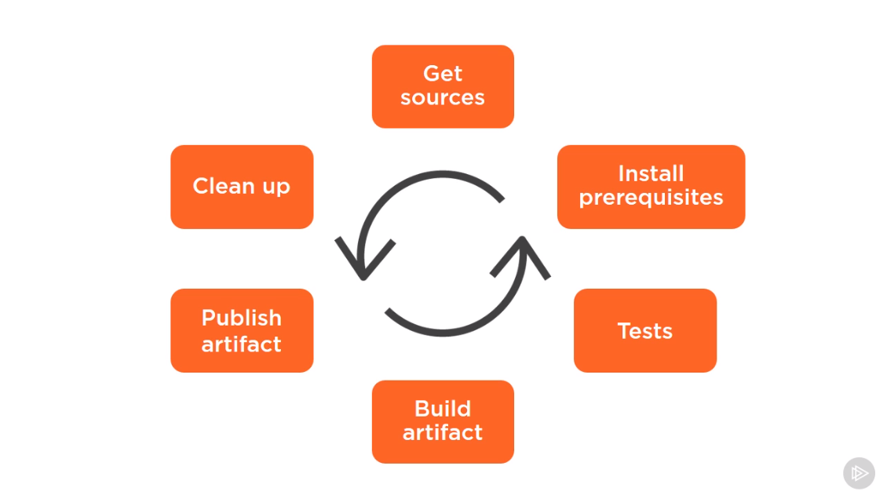
CI Pipeline
Notes:
Build Pipeline
VSTS Build Agents
Third Party Build tools
Release Pipeline
Hands-on demo

Slide 10
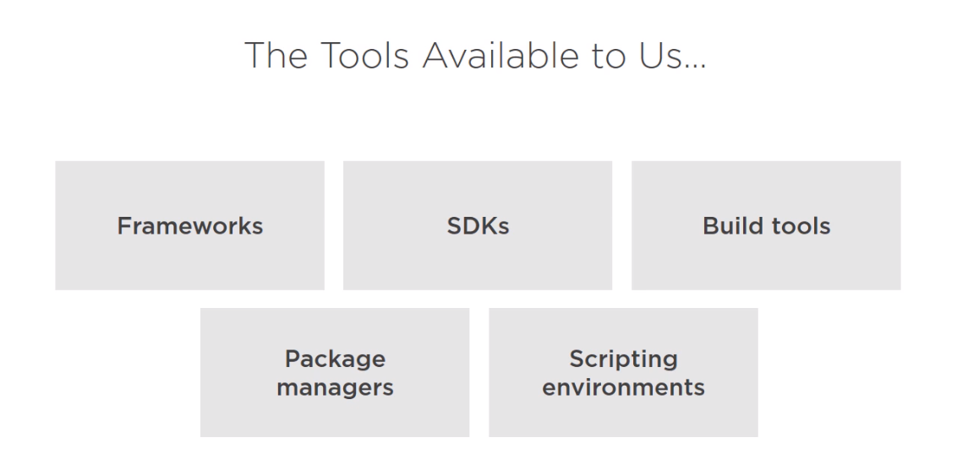
Notes:
Build Pipeline
VSTS Build Agents
Third Party Build tools
Release Pipeline
Hands-on demo

Slide 11
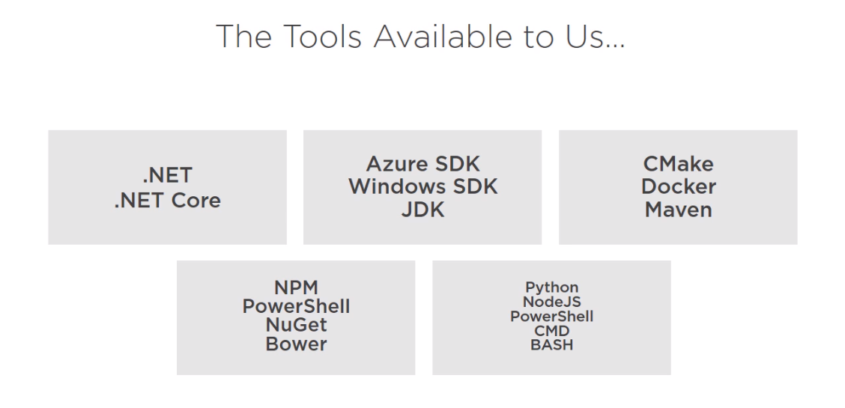
Notes:
Build Pipeline
VSTS Build Agents
Third Party Build tools
Release Pipeline
Hands-on demo

Slide 12
Third Party build tools
Ant
Grunt
CMake
Xcode Build
Grunt
Gulp
etc.
Notes:
Build Pipeline
VSTS Build Agents
Third Party Build tools
Release Pipeline
Hands-on demo

Slide 13
Let’s do it

Slide 14
References
Visual Studio Team Services Documentation https://docs.microsoft.com/en-us/vsts/
Visual Studio Team Services https://www.visualstudio.com/team-services/
Microsoft Virtual Academy http://bit.ly/DevOps_MVA

Slide 15
Thank You! ☺

