Slide 1


BizTalk Walkthrough
~A Microsoft’s Integration Tool
Vignesh Sukumar

Slide 2
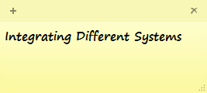
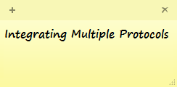
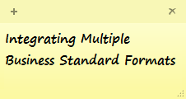

Biz Talk
Business Systems
Communication

Slide 3




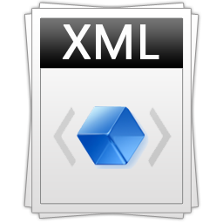






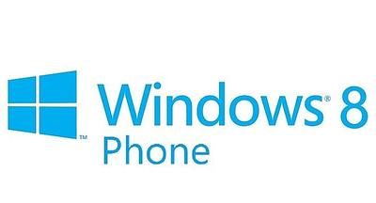


Why BizTalk?
Tightly Coupled Architecture
Web Services
File System
Ecommerce Website
RFC

Slide 4

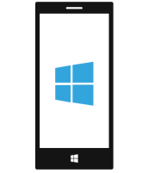




Why BizTalk? (Contd..)
X
Y
Scalable Architecture
Web Services
Ecommerce Website
File System
RFC
Vendor 4
Vendor N

Slide 5

Past-Present-Future of BizTalk

Slide 6



Past-Present-Future
BizTalk Server -2000
Integrating Different systems
BizTalk Server -2002
BizTalk Server -2004
BizTalk Server -2006
BizTalk Server -2006R2
Incorporated EDI and WCF based adapters capabilities
BizTalk Server -2009
BizTalk Server -2010
BizTalk Server -2013
BizTalk Server -2013R2/2016
Cloud based Integration and JSON capabilities
Code-less Integration
Azure BizTalk Services

Slide 7
Basic Artifacts in BizTalk
Schema
Maps/Transformations
Adapters
Orchestration
Pipelines

Slide 8


Schemas
Structural representation of the message
Format in which the different system expects the message to be.
Schema of the Message
Sample EAI Message
BizTalk Identifies the message using Message Type → Namespace + Root Name

Slide 9
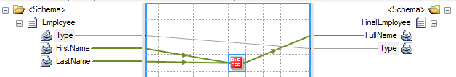

Maps
Transformational unit in BizTalk
Message is converted from one form to another form using maps
Input Message
Output Message

Slide 10
Adapters
Exposes the BizTalk endpoints to the Outside world
Adapts the message in a way that other system understands
DB Adapter
SMTP Adapter
File Adapter
HTTP Adapter
WCF/SOAP Adapter

Slide 11
Orchestration
A Visual Designer of Work flow process
Complex Business scenarios is architected here!

Slide 12
Pipeline
Messages gets routed through pipelines
Different stages in pipeline helps in message processing
Decodes the message
Converts the message BizTalk Understandable format(XML)
Pre-processing message before serialization
Validates the message
Serializes the message
Resolves the party through Identifiers in the message
Encodes the message
Receive Pipeline
Send Pipeline

Slide 13
Design Methodologies
Message-Only Solution
Orchestration-based Solution

Slide 14
Message-Only Architecture
1
Publish
2
Subscribe
Message In
Receive Port
Send Port
Message Out
1
2
Message Box
Adapters
Receive Pipeline
Filter
Send Pipeline
Adapters

Slide 15
Orchestration based Architecture
Orchestration
Message In
Receive Port
2
3
Send Port
Message Out
1
4
Message Box
Adapters
Receive Pipeline
Filter
Send Pipeline
Adapters
1
Publish by Receive Port
3
Publish by Orchestration
2
Subscribe by Orchestration
Subscribe by Send port
4

Slide 16

BizTalk Advanced Functionalities
Hybrid
Cloud
BRE
BizTalk
Server
BAM
EDI
Electronic Data Interchange
B2B
RFID
Partners
SAP System
IBM Main Frame
Siebel/Share point
Any Application Server

Slide 17





Advantages over the Competitors
Durable messaging using the proven publish-subscribe model
Highly scalable and customizable performance model
Integration with a broad range of security architectures
Quicker Solution
Pathway to the cloud integration
Easy Dot net Customisation
Evolving continuous development
Microsoft Support
License Friendly

Slide 18
Useful Links
BizTalk Installation Guide: https://msdn.microsoft.com/en-us/library/jj248681.aspx
BizTalk Server Architecture: https://msdn.microsoft.com/library/aa561521(BTS.70).aspx
BizTalk MSDN Repository: https://msdn.microsoft.com/en-us/biztalk/aa937640.aspx
BizTalk Tutorials: https://msdn.microsoft.com/en-us/library/aa560270.aspx

Slide 19

Queries

Slide 20
Thank You! ☺
#HappyIntegrating

