Slide 1
Back Tracking of Issues –Before Escalating to Developer
Mekala Ramesh
-Lead QA & Product Support

Slide 2
What is back tracking in general?
Word itself has the meaning
Erroneous in the flow
Go back to the travelled way
In simple words
“Detecting the problem with exact root cause”

Slide 3
In a software testing context
It is a main essence for testing
Based on experience bug reporting skill differs
Novice
Intermediate
Expert
Less Risk

Slide 4
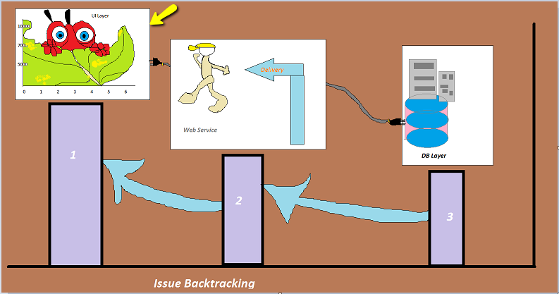
Issue back tracking an example
Generally software has three layers,
UI
Web Service
Database

Slide 5
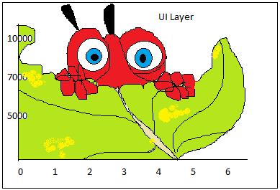
UI Layer
Binding issue
Look for the console error, if any
Browser issue
The exception is not handled properly

Slide 6
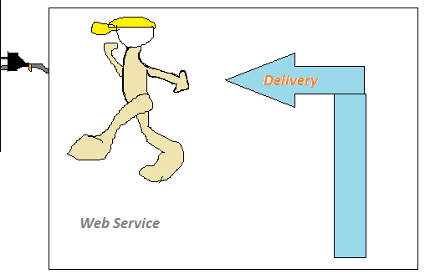
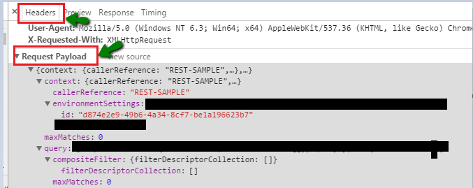
Service Layer
Method Identification
GET
POST

Slide 7
Database layer
Log files

Slide 8
Thank you !!!
When you don't identify and reduce risks at the beginning of a project, they can often become issues later on. Make sure you understand your risks early. Learn from previous projects, and benefit from the team's past experiences. This way, you'll have fewer issues to manage as you move forward.

