Slide 1
Azure Service Bus
Rajesh

Slide 2
Agenda
What is Azure Service Bus
Service Bus fundamentals
Types of communication mechanism's
Queue
Topic
Relay
ServiceBus360
Conclusion

Slide 3
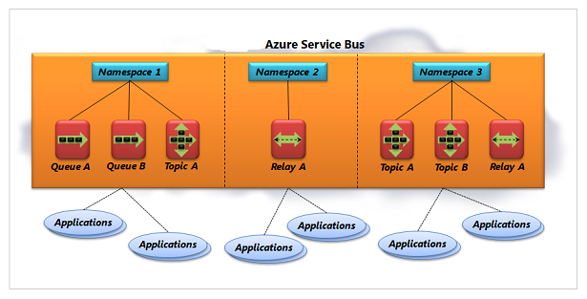
Fundamentals of Service Bus

Slide 4
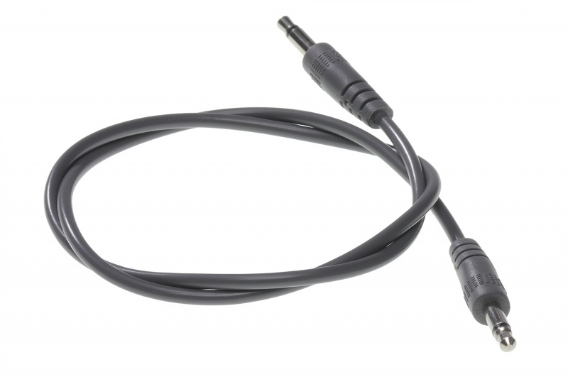
What do you think?

Slide 5
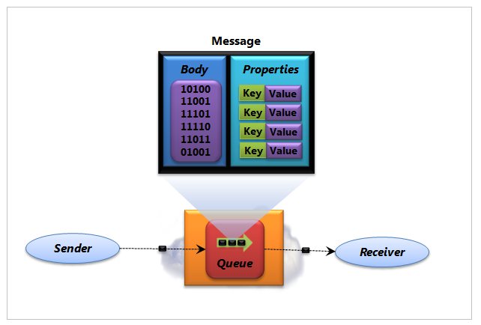
Queues
Ways to read messages from Queue
ReceiveAndDelete
PeekLock

Slide 6
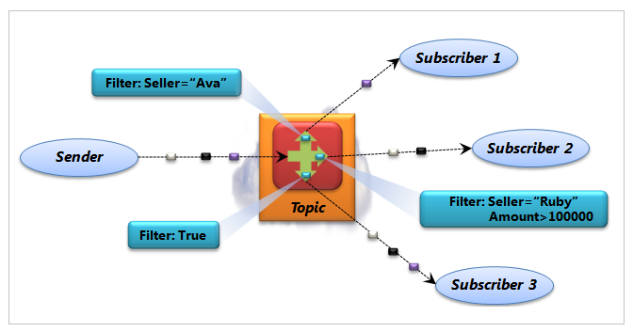
Topics
Ways to read messages from Topic
ReceiveAndDelete
PeekLock

Slide 7
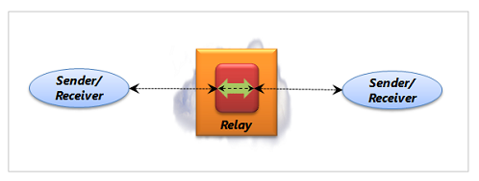
Relays

