Slide 1
Azure Event Grid with Custom Events
@kuppurasu360
Notes:
New Service and very important componets added by Microsoft
This new service fully managed intelligent event routing mechanism
It allows communication though pub to lin
Azure Event Grid is a fully managed event routing service.

Slide 2
Agenda
What is Serverless computing?
Serverless Components in Azure
Introduction to Azure Event Grid
​Event Grid Concepts
Built-in publisher and handler integration
Concepts
Capabilities
What can we do with Event Grid?
Service Bus vs Event Grid
Event Grid vs Logic Apps and Event Hubs
Event Grid cost
Demo

Slide 3
What is Serverless computing?
Serverless computing allows us to build and run applications and services without thinking about servers.
Serverless computing is the abstraction of servers, infrastructure, and operating systems.
5 Key Characteristics
No Server management
Flexible Event-driven scaling
Highly available
No idle capacity
Micro Billing
Notes:
When we build serverless apps we don’t need to provision and manage any servers, so we can take our mind off infrastructure concerns.
Key
There is no need to provision or maintain any servers
we shouldn’t worry about scaling our solution if demand arises
Serverless applications have built-in availability and fault tolerance.
We don’t have to pay for idle capacity. If your code is not running, We shouldn’t pay for it.
When our code is executed we pay per execution.

Slide 4
Serverless Components in Azure
Notes:
SaaS event processing. Azure Functions supports triggers based on activity in a SaaS service. Azure Functions is a solution for easily running small pieces of code, or "functions," in the cloud
Logic Apps provide a way to simplify and implement scalable integrations and workflows in the cloud
Without writing code, you can integrate systems and services by building and running automated workflows with Azure Logic Apps

Slide 5
What is Azure Event Grid?
Azure Event Grid is built specifically for Serverless architectures.
It manages all routing of events from any source, to any destination, for any application.
Event Grid is an eventing backplane that enables event-driven, reactive programming.
It is deeply integrated with Azure services and can be integrated with third-party services.
Event Grid is not a data pipeline, and does not deliver the actual object that was updated.
Notes:
Azure Event Grid greatly simplifies the development of event-based applications and simplifies the creation of serverless workflows.
Fully-managed event routing service

Slide 6
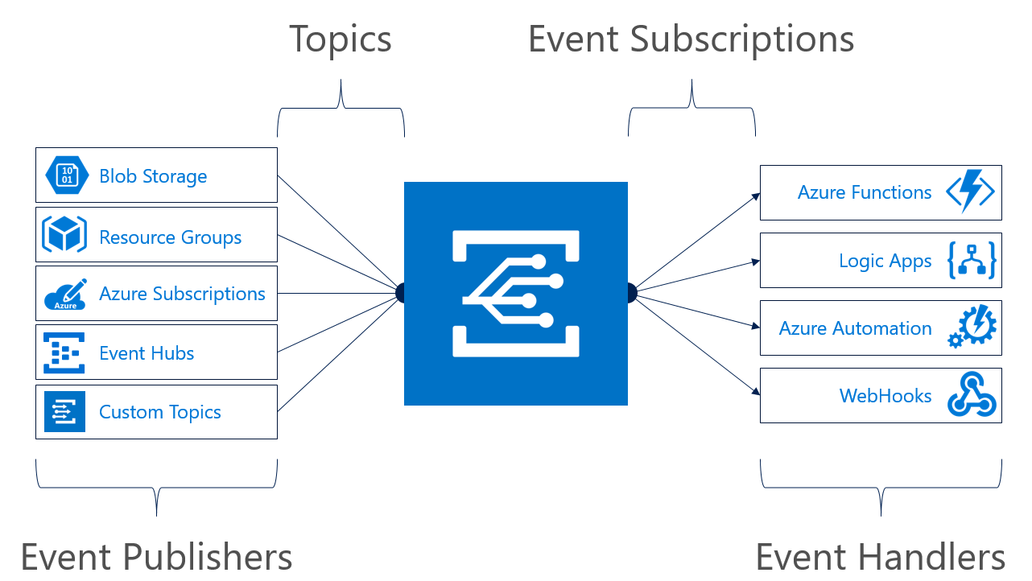
Event Grid
Notes:
At the basic level, similarly to Azure Service Bus, a Topic is an endpoint that receives messages, and a Subscription is used to receive messages through the Topic that will be handled by a message listener.

Slide 7
Built-in Publisher & Handler integration
Azure offers built-in event support using numerous services, including both publishers and handlers.
Publishers
Currently, the following Azure services have built-in publisher support for event grid:
Resource Groups (management operations)
Azure Subscriptions (management operations)
Event Hubs
Custom Topics
Note : Other Azure services will be added this year.

Slide 8
Built-in publisher and handler integration
Handlers
Currently, the following Azure services have built-in handler support for Event Grid:
Azure Functions
Logic Apps
Azure Automation
WebHooks
Microsoft Flow
Note : Other Azure services will be added this year.

Slide 9
Concepts
There are five concepts in Azure Event Grid that let you get going:
Events - What happened.
Event sources/publishers - Where the event took place.
Topics - The endpoint where publishers send events.
Event subscriptions - The endpoint or built-in mechanism to route events, sometimes to multiple handlers. Subscriptions are also used by handlers to intelligently filter incoming events.
Event handlers - The app or service reacting to the event.

Slide 10
Capabilities
Here are some of the key features of Azure Event Grid:
Simplicity - Point and click to aim events from your Azure resource to any event handler or endpoint.
Advanced filtering - Filter on event type or event publish path to ensure event handlers only receive relevant events.
Fan-out - Subscribe multiple endpoints to the same event to send copies of the event to as many places as needed.
Reliability - Utilize 24-hour retry with exponential backoff to ensure events are delivered.

Slide 11
Capabilities - Cont
Pay-per-event - Pay only for the amount you use Event Grid.
High throughput - Build high-volume workloads on Event Grid with support for millions of events per second.
Built-in Events - Get up and running quickly with resource-defined built-in events.
Custom Events - use Event Grid route, filter, and reliably deliver custom events in our app.

Slide 12
What can we do with Event Grid?
Serverless application architectures
Event Grid connects data sources and event handlers.
Notes:
For example, use Event Grid to instantly trigger a serverless function to run image analysis each time a new photo is added to a blob storage container.

Slide 13
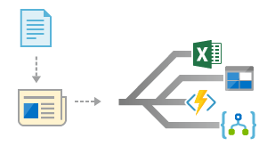
What can we do with Event Grid?
Application integration
Event Grid connects your app with other services.
Notes:
For example, create a custom topic to send your app's event data to Event Grid, and take advantage of its reliable delivery, advanced routing, and direct integration with Azure. Alternatively, you can use Event Grid with Logic Apps to process data anywhere, without writing code.

Slide 14
Service Bus vs Event Grid
Service Bus is well suited for traditional enterprise applications that require transactions, ordering, duplicate detection, and instantaneous consistency.
Event Grid is designed for speed, scale, breadth, and low cost in a reactive model. It is well suited to serverless architecture.

Slide 15
Event Grid vs Logic Apps and Event Hubs
Event Grid triggers the logic app to begin its workflow.
Event Hubs works with Event Grid by enabling us to react to events from Event Hubs Capture, and build data ingress and transformation pipelines.
Notes:
Event Grid complements other Azure services like Logic Apps and Event Hubs.

Slide 16
How much does Event Grid cost?
Azure Event Grid uses a pay-per-event pricing model, so we only pay for what we use.
Event Grid costs $0.60 per million operations ($0.30 during preview) and the first 100,000 operation per month are free.

Slide 17
Demo – Custom Events

Slide 19
Resources
https://docs.microsoft.com/en-us/azure/event-grid/
https://www.serverless360.com/blog/what-is-serverless-computing
https://www.servicebus360.com/blogs/azure-service-bus-event-hub-event-grid-one-choose/

