Slide 1
Azure Cosmos DB
Venitta J

Slide 2
Agenda
Azure Cosmos DB
Key capabilities
Develop an app with Cosmos DB
Azure Cosmos DB Emulator

Slide 3
What does NOSQL Mean?
Class of database management systems (DBMS) that do not follow all of the rules of a relational DBMS.
Interpreted as "No SQL," and most translate it as "Not Only SQL.
This type of database is not generally a replacement but, rather, a complementary addition to RDBMS and SQL.

Slide 4
Type of NOSQL
NOSQL
DOCUMENT BASED- DOCUMENT DB/Cassandra
Graph – Neo4j, SAP HANA
Key Value Pair –Redis, Azure Storage
Column Based- Cassandra

Slide 5
Comparison B/W SQL & NO-SQL
SQL
Relational
SCALE UP/Horizontally Scalable
NOSQL
Non-Relational
Scale OUT/Horizontally Scalable
Atomic Transaction
Difficult for programmer
Semi or unstructured data
Structured or Schema
EVENTUAL CONSISTENCY
Eg. Park a car in parking
Easy for Programmers
Eg. CAR Disassembled in and reassembled when required.

Slide 6
What is Azure Cosmo DB
Globally distributed database.
Enable you to elastically and independently scale throughput.
Storage across any number of geographical regions with a comprehensive SLA.

Slide 7
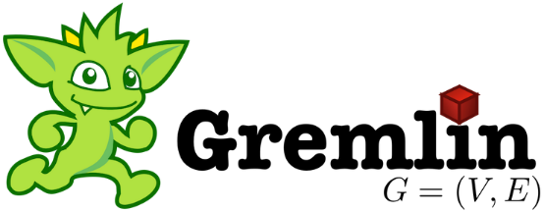
SQL
DocumentDB
Azure Tables
(future)
Azure Cosmos DB
Key-Value
Column-Family
Documents
Graph
Global distribution
Elastic scale out
Guaranteed low latency
Tunable Consistency
Comprehensive SLAs
A multi-model, globally-distributed database service

Slide 9
Key Capabilities
Turnkey global distribution
Multiple data models and popular APIs for accessing and querying data.
Elastically scale throughput and storage on demand, worldwide.
Build highly responsive and mission-critical applications.
Ensure "always on" availability.
Write globally distributed applications, the right way.
Money back guarantees.
No database schema/index management.
Low cost of ownership

Slide 10
Capability comparison
Capabilities | Relational databases | Non-relational (NoSQL) databases | Azure Cosmos DB
Global distribution | No | No | Yes, turnkey distribution in 30+ regions, with multi-homing APIs
Horizontal scale | No | Yes | Yes, you can independently scale storage and throughput
Latency guarantees | No | Yes | Yes, 99% of reads in <10 ms and writes in <15 ms
High availability | No | Yes | Yes, Cosmos DB is always on, has PACELC trade-offs, and provides automatic & manual failover options
Data model + API | Relational + SQL | Multi-model + OSS API | Multi-model + SQL + OSS API (more coming soon)
SLAs | Yes | No | Yes, comprehensive SLAs for latency, throughput, consistency, availability

Slide 11
Develop an app with Cosmos DB
DEMO

Slide 12
Azure Cosmos DB Emulator
Provides a local environment that emulates the Azure Cosmos DB service for development purposes.
You can develop and test your application locally, without creating an Azure subscription or incurring any costs.

Slide 13
DEMO

Slide 15
Thank you

