Slide 1
Introduction to Cognitive Services
Sriram Hariharan

Slide 2
Agenda
What are Cognitive Services?
Types of Cognitive Services
Demos

Slide 3
Cognition
The mental action or process of acquiring knowledge and understanding through thought, experience, and the senses Wikipedia

Slide 4
What are Cognitive Services?
Cognitive services are a set of APIs
Designed to democratize artificial intelligence by enabling systems to see, hear, speak, understand and interpret our needs using natural methods of communication
Structured semantic data to human knowledge with a degree of confidence
“A picture of Rajinikanth Happy”
This is about a person
Image of person
Emotional readings
“x% sure that this person is [highest emotion]”
Notes:
We want the machine to draw out those semantics and tell us with what degree of confidence, those semantic interpretations are correct. And if we can get some structured data values or entities in and out then even better.

Slide 5
Case Study

Slide 7
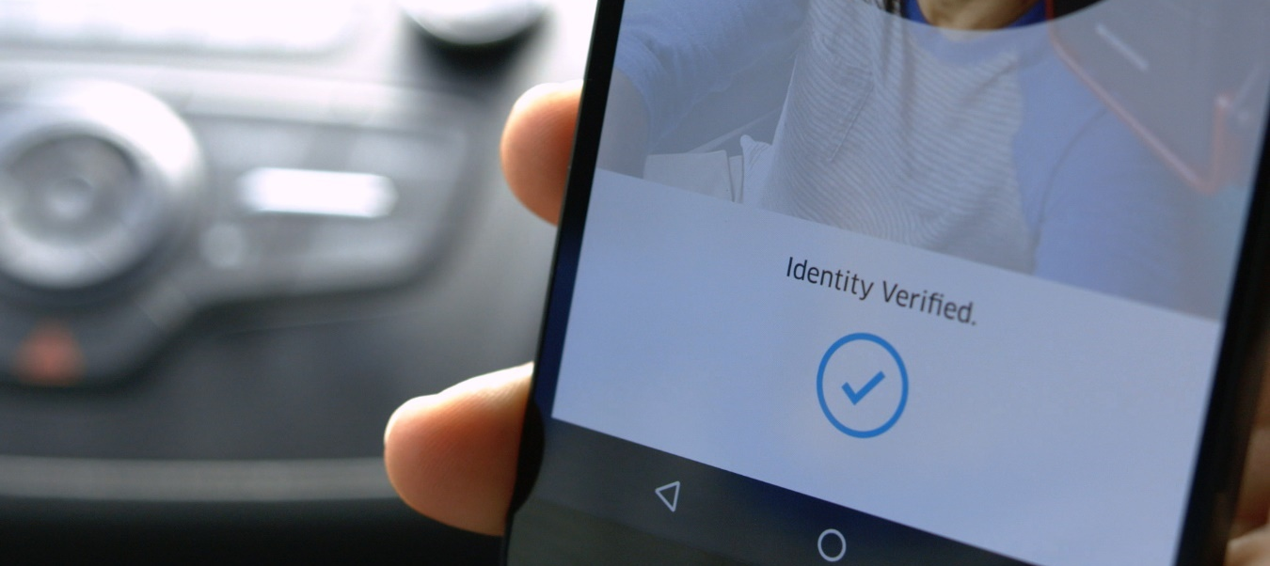
Case Study – Details ….
Compares photos with varying pose, focus, and lighting conditions, which is critical for uncontrolled conditions like drivers taking selfies at night in their cars
Match within milliseconds
Integrated with Java front-end and Go backend (with Python) in 3 weeks.

Slide 8
Types of Cognitive Services
Vision | Speech | Language | Knowledge | Search
Notes:
The services available break down broadly into these 5 categories bringing together new and existing service offerings under the Cognitive Service umbrella. New services are added, and existing services enhanced over time.

Slide 9
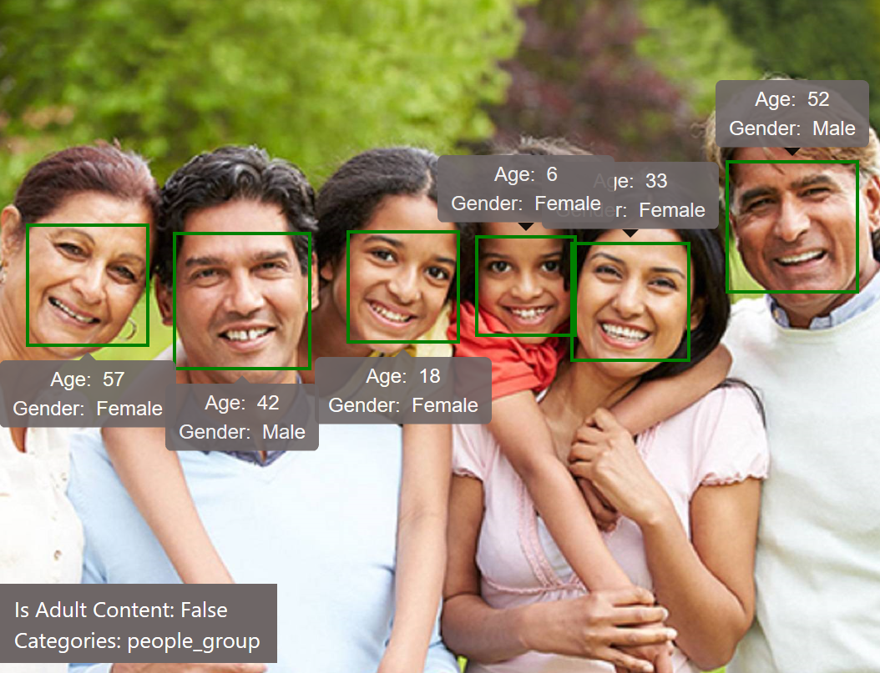
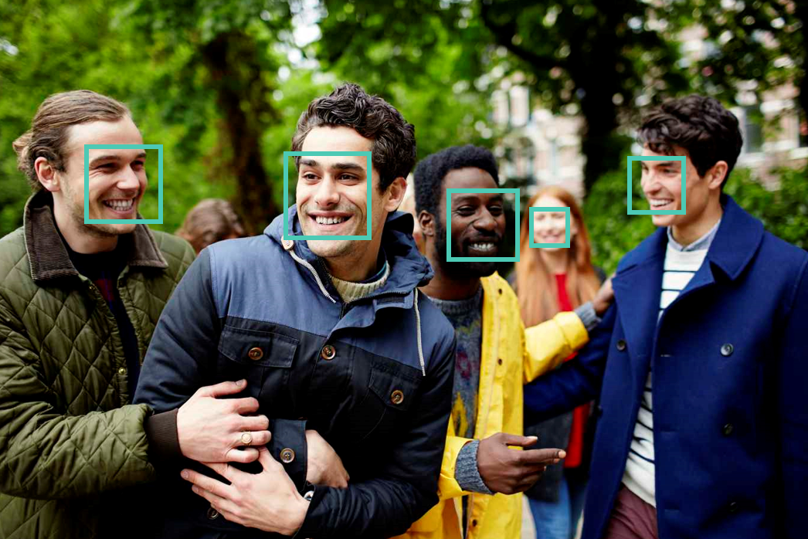
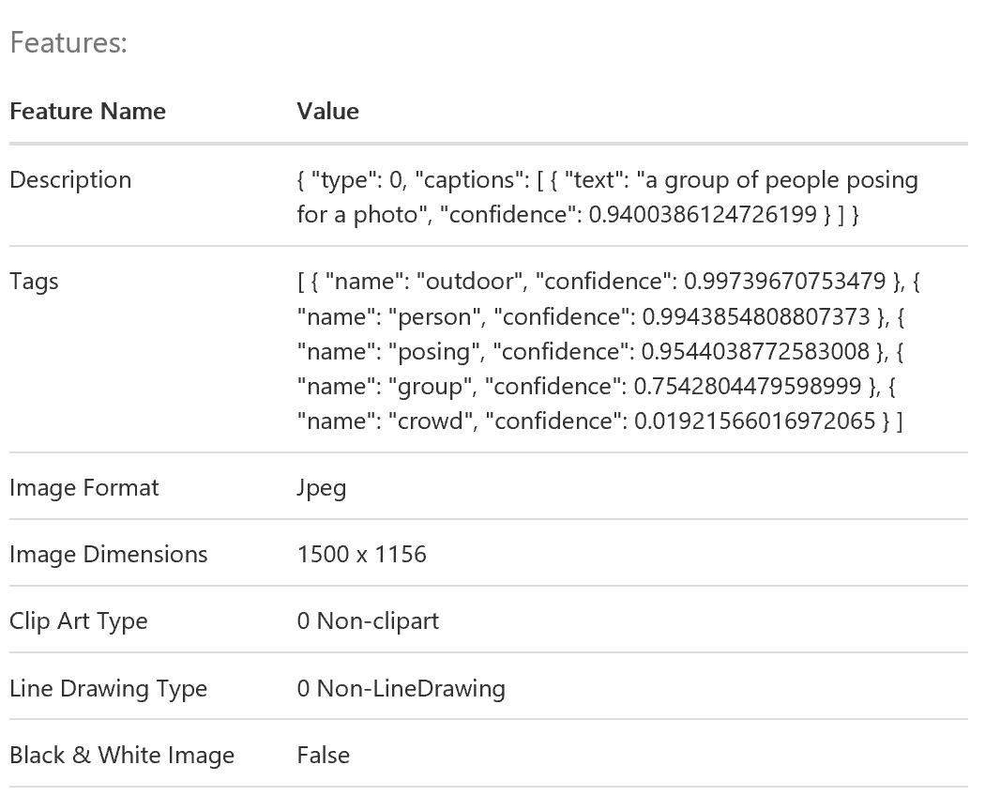
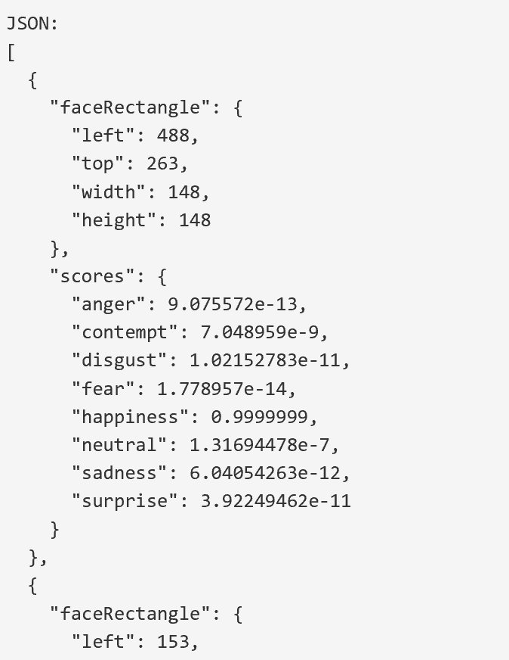
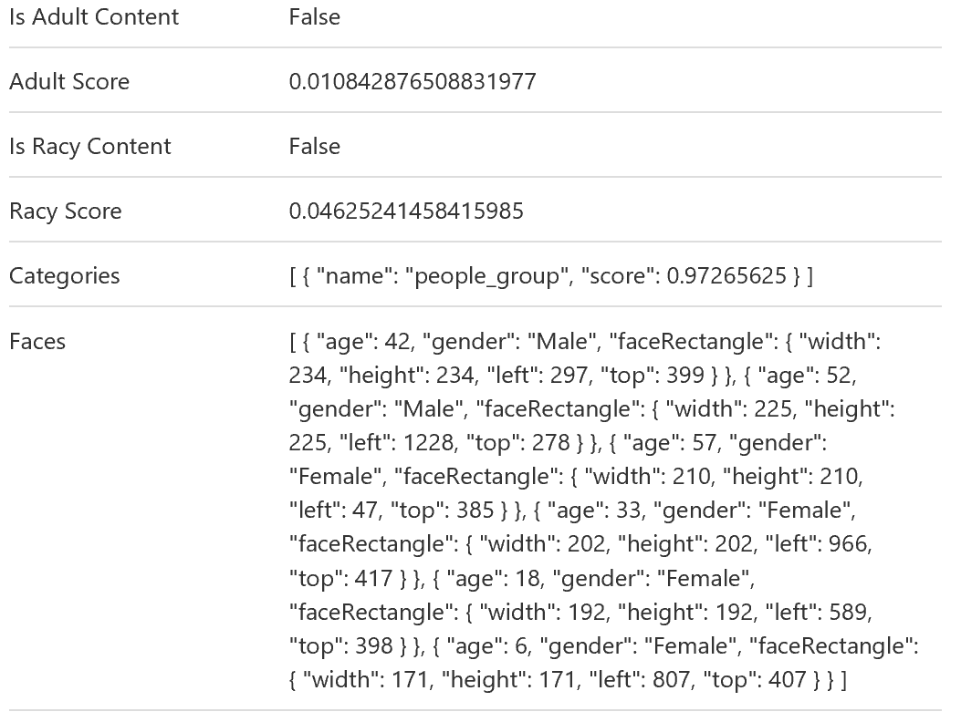
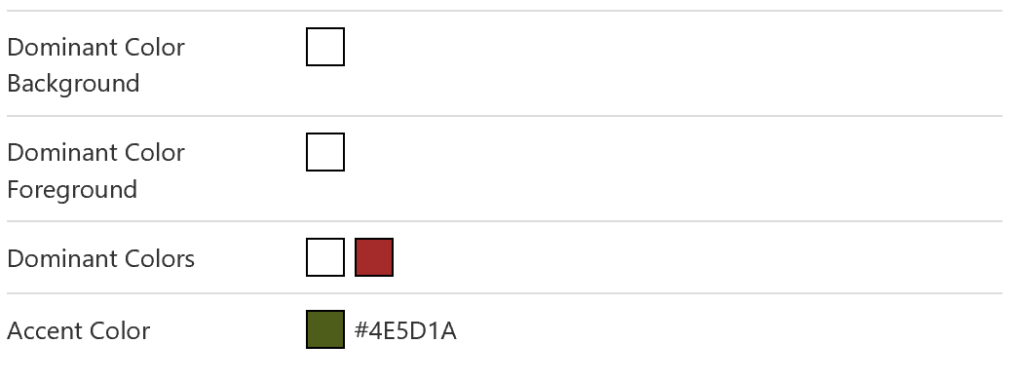
Vision
Computer Vision
Content Moderator
Emotion
Face
Video
Stabilize video, track multiple faces over time, do motion detection and generate thumbnails
Gender, age, pose orientation, smile and facial hair, along with the position of 27 facial landmarks (for example, eyebrow position, nose position, lips, etc).
Detect and filter out content undesirable to you individuals, groups or organizations.
Summary of what is in the image, tags for image content, adult type assessment content, location of faces, age of the person, dominant colours in the image
Confidence rating for major emotions after also locating faces in an image
Notes:
CLICK – Computer Vision
The computer vision service provides a vast wealth of information from a single picture. In includes a summary description of what it finds in the image, tags for the image content, an assessment of the image type including whether it is adult content, the locations of faces in the picture, including an estimate of the age of each person, and the dominant colors it finds in case you want to adapt an application to match with an image.
CLICK – Content Moderator
Image, video (as well as text moderation) is available to enable you to detect and filter out content undesirable to you individuals, groups or organizations.
CLICK – Emotion
Emotional recognition can be used to enhance many experiences both personal and in business. The Emotion API give you a confidence rating for major emotions after also locating faces in an image.
CLICK - Face
Beyond just emotion machine learning, the Face API can give you information on gender, age, pose orientation, smile and facial hair, along with the position of 27 facial landmarks (for example, eyebrow position, nose position, lips, etc).
CLICK - Video
The video APIs allow you to stabilize video, track multiple faces over time, do motion detection and generate thumbnails. Combine still captures with the other vision service to create a power analytics tool.

Slide 10
Speech
Bing Speech
Custom Speech Engine
Speaker Recognition
Voice authentication purposes
When creating a game that needs domain specific words to be spelt correctly; Define Language Model
Convert spoken audio to text and vice-versa
Notes:
CLICK – Bing Speech
Bing speech brings speech-to-text to applications allowing you to use voice as a more natural input. The audio can come from a microphone, file or other audio source. Results can be returned in real-time as the audio is sent to the service. Recognition can also be combined with other services. For example, you can get intent of the speaker’s phrase directly from the APIs after some training. And of course there’s also text to speech so your application can respond in kind in a number of languages and voices.
CLICK – Custom Speech Engine
If you are creating a game or a voice interface to a specific tool you’ll want to be sure that domain-specific words and phrases don’t trip up the recognition system. With the Custom Speech Engine, you can create a language model that will assist with the recognition. Not only that but you can create acoustic models that will help with the low quality audio in uncooperative environments. With those made, you can deploy them to a custom recognition end point ready to handle your specific scenario.
CLICK – Speaker Recognition
With Speaker Recognition, your voice is your passport both to authenticate you as an individual (with sample training) and also to identify you amongst a group of known speakers.

Slide 11
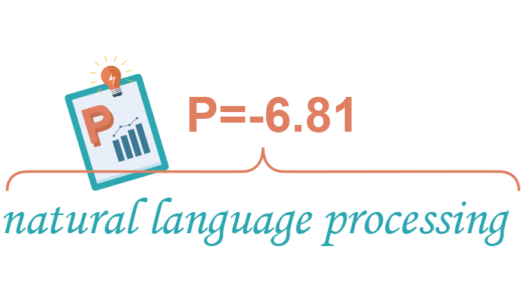
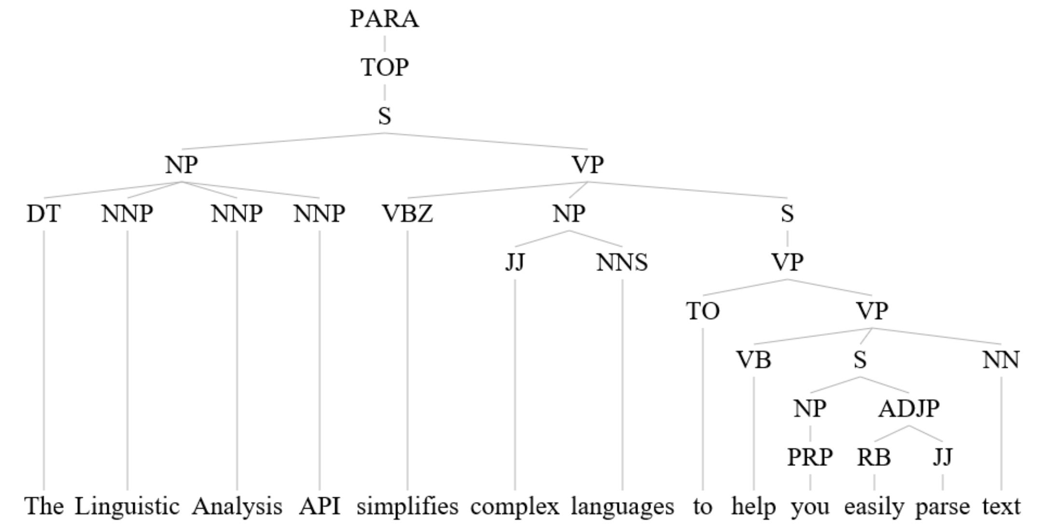
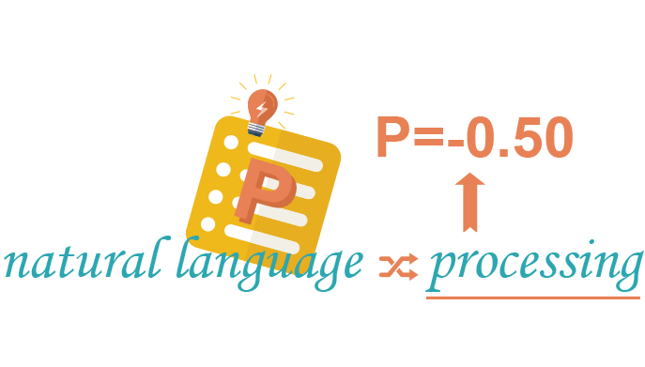
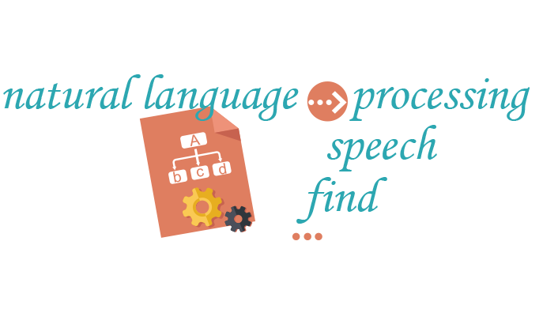
Language
Bing Spell Check
Linguistic Analytics
Text Analysis
Translator
WebLM
Language Understanding
Useful for Bots to understand user input
Proof Reading - Word breaks, Slang, Names, Homonyms and Brands
Dig deeper into sentence structure, Useful for Bots
Speech translation in 9 languages Text translation in 60 languages.
Useful for sentiment analysis
Notes:
CLICK – Spell Check
Bing Spell check provides the power of correction in any application. Call the service with text and select either Proofing (for light document corrections) or Spelling for full-power correction.
CLICK – Linguistic Analysis
If you really want to dig into the structure of a sentence, then Linguistic Analytics gets you a full drill-down tree of the parts of a sentence. If you are building a bot, you may want to use this capabilities.
CLICK – Text Analytics
Beyond structure trees, there’s more summary information in text that you may want to know. You can find out in which language the text was written, which parts of the text are the key phrases andoverall, the sentiment of the text whether positive or negative. For language detection and sentiment, you get a percentage of confidence.
CLICK – Translator
As with Text Analytics you can do automatic language detection, but of course you can do translations. These can be speech translation in 9 languages and text translation in 60 languages. You can improve translation by providing reference dictionary translations and sample sentences. There’s also a collaboration workflow framework allowing contributors to suggest translations and for others to approve a result.
CLICK – WebLM
WebLM provides a series of APIs around the probability of various language sequences based on language modelling. If can do things like split words when spaces have been missed, get the probability of a sequence, the probability of a specific word coming next, and next word suggestions. You may have seen these kinds of things in action when typing on your mobile device’s keyboard.
CLICK – Language Understanding
The Language Understanding Intelligent Service, or LUIS is a key service. The user sets up a series of intentions and provides examples of text that portray that intention. The service is then trained on those samples so that it can then recognize which intention a new arbitrary sentence is portraying. This is great for use in bots, where the bot needs to know what intention or action a user is attempting to perform. The service may also extract specific entities (often nouns) from the text and pass those along too. The service also indicates the confidence with which it determines a specific intent is present.

Slide 12
Knowledge
Academic
Entity Linking
Knowledge Exploration (similar to Academic)
QnA Maker
Recommendations
Create FAQ content easily from content. Can be re-presented as bot interfaces!
Predict what your customers want!
E.g., Amazon (Frequently bought together)
Auto-complete as you enter text; information retrieved from Microsoft Academic Graph
http://aka.ms/academicgraph
Recognize and identify each separate entity based on the context from a paragraph
Notes:
CLICK - Academic
The Academic APIs draw on knowledge to allow for sophisticated auto-completion experiences by interpreting text and adding annotations, they also do queries against Academic knowledge, returning structured entities, then allow for the return of statistic data around those results, and also allow you to find if two pieces of text are portraying the same concepts and also search for a specific graph pattern.
CLICK – Entity Linking
This API can use recognized entities (about which knowledge can be found, e.g. on Wikipedia) used throughout a piece of text and link together those which are the same, based on context.
CLICK – Knowledge Exploration
Similar to the Academic APIs, these APIs interpret language as structured queries, enable auto-completion, retrieve information about real-world entities, and provide attribute statistics.
CLICK – QnA Maker
This service can be used initially to extract regularly published FAQ Q&As and re-present them as a conversational bot interface or other interactive interface. The underlying model is trained on existing Q&As and can be manually adjusted.
CLICK – Recommendations
Perhaps one of the most heard-about uses of automated knowledge, these APIs can, given a history of data, give suggestions of items previously associated together (perhaps in a store purchase), show other relevant items based on previous users’ activity, or items personalized to the user’s own previous activity.

Slide 13
Search
Bing Autosuggest
Bing Image Search
Bing News Search
Bing Video Search
Bing Web Search
Notes:
CLICK – Autosuggest
Add to your app or website by using Autosuggest on the text a user is typing to help them complete it more quickly
CLICK – Image Search
Image Search does what you’d expect, but you can also specify geographic market, safe search options, color, freshness, type, license type and size. You’ll get back Urls, including one for the hosting page of the image.
CLICK – News Search
Search for news, getting back an image, provider info, URLs, categories and date.
CLICK – Video Search
Search with text for video optionally specifying market, safe search level, pricing, freshness, resolution and length. Get back the Url, author info, length, format and even view count.
CLICK – Web Search
And of course, you can do a web search, optionally filtering down to images, news, video and web pages.

Slide 14
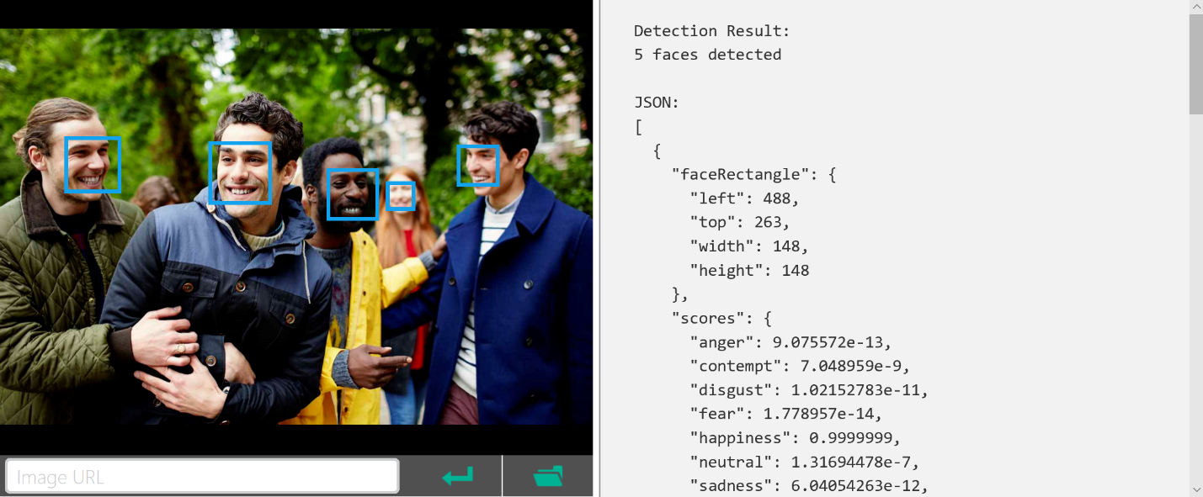
REST/JSON-based Services
Notes:
As you’ve likely gathered, all the results come from the Cognitive services as structured data using JSON. The services themselves are available as REST end-points. This makes it incredibly easy to access the services from any device with a TCP/IP heartbeat and some basic text processing. The data returned is in a logical hierarchy. Often some services do similar things or include the results from one or more other services in which case there’s typically a consistent format for the data used for the same data entities across different calls.

Slide 15
Demo
Calling Cognitive Services
Notes:
Demo 1.2
Let’s see how easy it is to get going with a call to Cognitive Services…

Slide 16
Summary
Explored services that bring structured semantic data to human I/O with a degree of confidence
Saw examples of companies using these services
Learned the basics of getting connected
Saw an example of multiple services working together for a specific scenario
Notes:
CLICK – structure semantics from human I/O
So we’ve explored Cognitive Services that provide (or use) structure semantic data to human I/O while also providing the degree of confidence in the semantic interpretation.
CLICK – Real deeply integrated commercial/gaming use
We saw examples of companies using these services deeply at the core of what they do.
CLICK – Exploring more
We saw where you can find out more and how easy it is to get started from almost any platform.
CLICK – Chaining services example
With the Research scenario, we saw how you get to use multiple services chained together to automate a process and provide some real value when building content.

Slide 17
Resources
Learn and try at - https://www.microsoft.com/cognitive-services
Docs & getting started - https://docs.microsoft.com/en-us/azure/cognitive-services/
Cognitive Services example code - https://github.com/Microsoft/Cognitive-Samples-IntelligentKiosk
Notes:
As shown

Slide 18
Thank You

