Slide 1
Introduction to Azure Bot Framework
Umamaheswaran (UMW360)

Slide 2
Conversation as a platform - CaaP

Slide 3
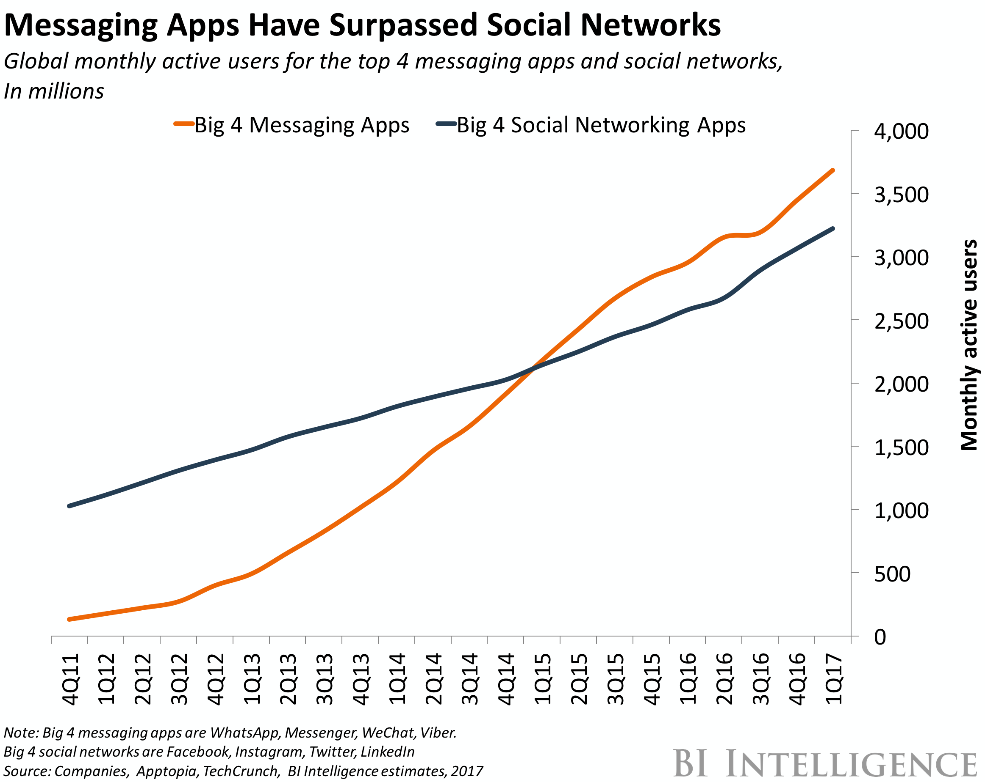
Messaging is King
Monthly active users of the top 4 messaging apps surpassed monthly active social network app users in Q1 2015

Slide 4
Bot or not?
Don’t just search query results
Act as agent for user
Translate user intent
Perform actions
Combine data from multiple sources
Maintain dialog context
May exhibit personality

Slide 5
Forecasts
65% of smart phone owners already use voice assistants on their phone
By 2018, at least 50% of the newest versions of enterprise software products will include some CaaP-based capabilities
80% of executives believe artificial intelligence improves worker performance and create jobs
By 2020, at least 80% of new enterprise application releases will make reasonably strong use of chat bots

Slide 6
Potential Benefits
Engage with the chat-generation
Lowered business cost to serve internally and externally
Improved resource focus on other tasks
More quickly connect users with information and services
Act as a friendly navigator for legacy or cumbersome data

Slide 7
Industry Momentum
800 M
Monthly active WeChat users,200M with credit cards linked to their accounts
67,000
Developers on Microsoft Bot Framework
55,000
15,000
Bot developers on Facebook
Skills in the amazon Alexa store

Slide 8
Expedia

Slide 9
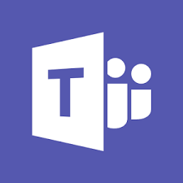
Where do they live?

Slide 10
Tools
Bot framework SDK for .NET
Bot framework SDK for node.js
Emulator
Azure(or any website) for hosting
Registration portal

Slide 11
The Cognitive Services
VISION
Computer Vision
Content Moderator
Emotion
Face
Video
SPEECH
Bing Speech
Custom Speech
Service
Speaker
Recognition
LANGUAGE
Bing Spell Check
Language Understanding
Linguistic Analysis
Text Analytics
Translator
WebLM
KNOWLEDGE
Academic
Entity linking
Knowledge Exploration
QnA Maker
Recommendations
SEARCH
Bing Autosuggest
Bing Image Search
Bing News Search
Bing Video Search
Bing Web Search

Slide 12
LUIS
“Language Understanding Intelligence Services”
For an app, LUIS deals in a number of “Intents“ & “Entities”
Trained with a number of “Utterances” for each intent with Entity placement.
Determines with a degree of confidence which intent was meant from a given phrase
Provides the Intent and extracted Entities to application
Developer can see stats on Intents selected by LUIS over time and can guide the training based on actual user utterances

Slide 13
Summary
Messaging has become a dominate for of communication
There a significant cost saving, efficiency and user connection benefits to using bots
The bot framework enables bots to be built in several languages, be hosted in many places and appear in many channels
Cognitive services bring significant power to the framework

Slide 14
Resources
dev.botframework.com
microsoft.com/cognitive-services

